Slide 1
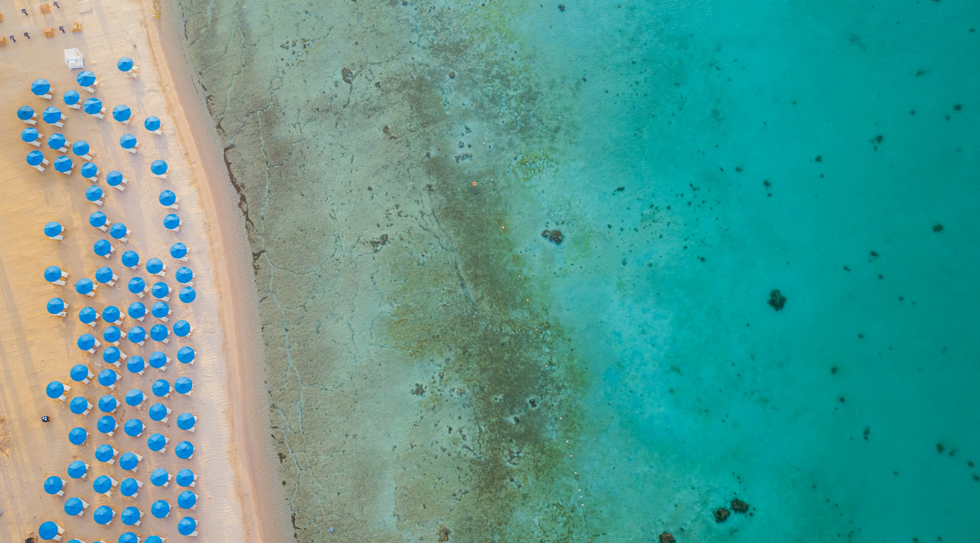
Luxury speaking for itself

Slide 2
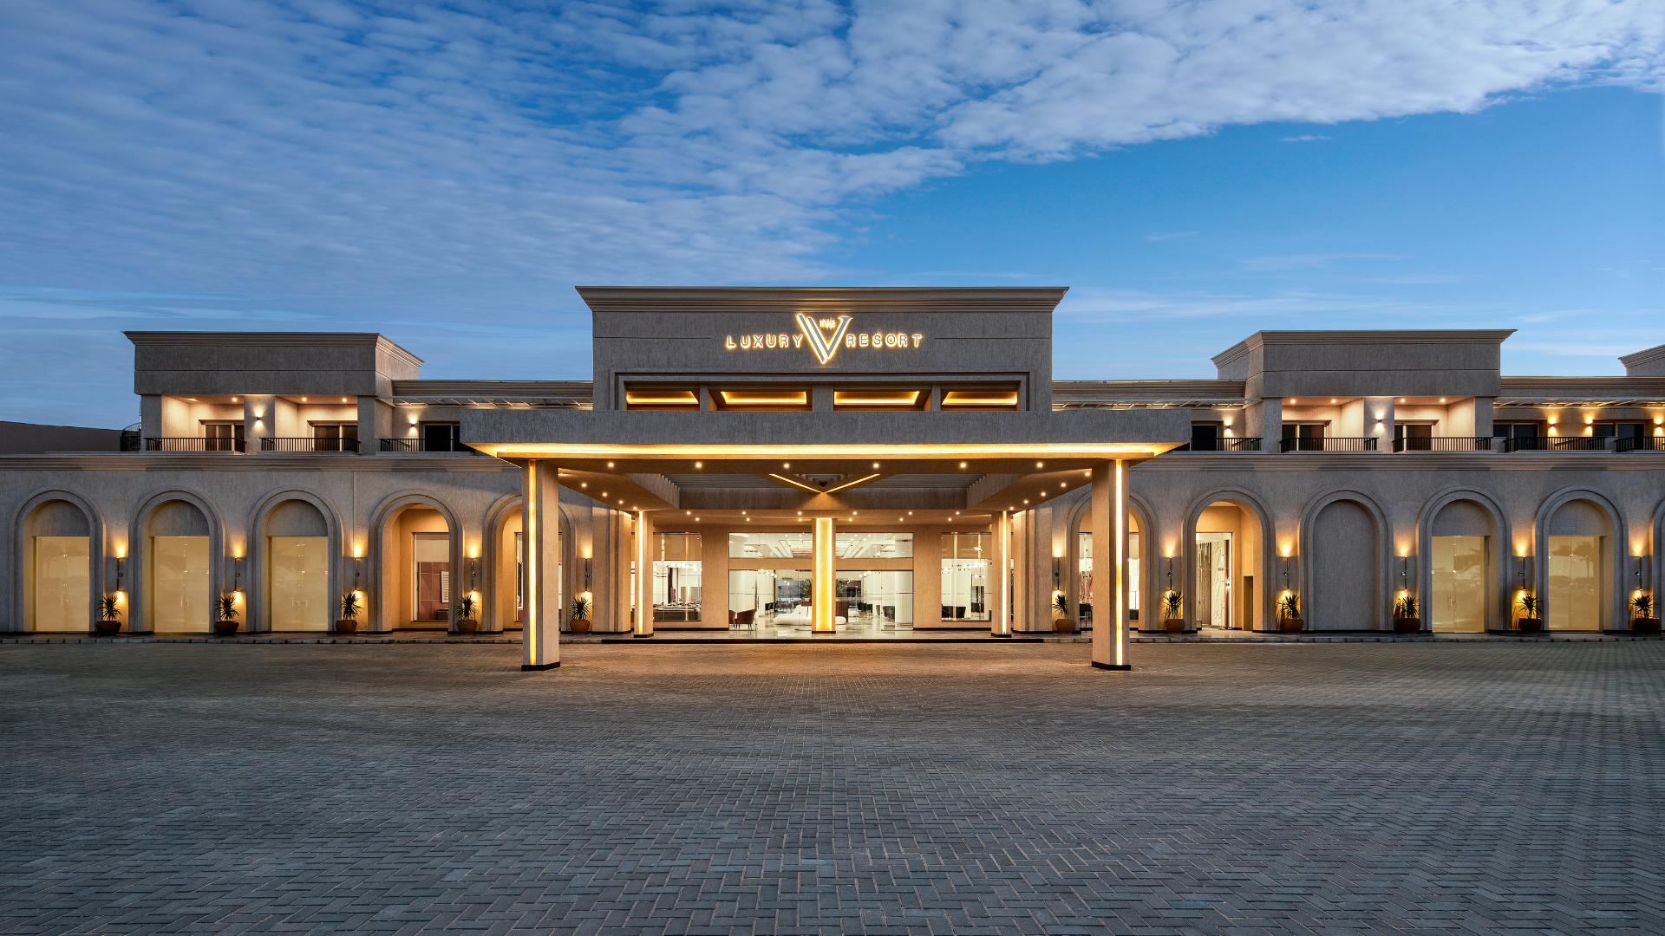
Resort Overview
An escape from the big and busy city life to the beauty and magic of Sahl Hasheesh.
The V Luxury Resort takes you on a magical getaway in one of the most beautiful destinations in Egypt.
We create the right ambiance for vacationers to unwind and make the best of their stay in a modern and upscale destination while enjoying the splendour of nature around them.

Slide 3
Location
Mailing Address
Total Number of Rooms
Website
Email
Hurghada, Sahl Hasheesh, Red Sea Governorate, Egypt
info@thevhotelsegypt.com
reservation@thevhotelsegypt.com
301 total number
thevhotelsegypt.com
Telephone
Beach Location
Category
Date of Opening
+20 1278575677
Private beach
5* Deluxe
2023

Slide 4
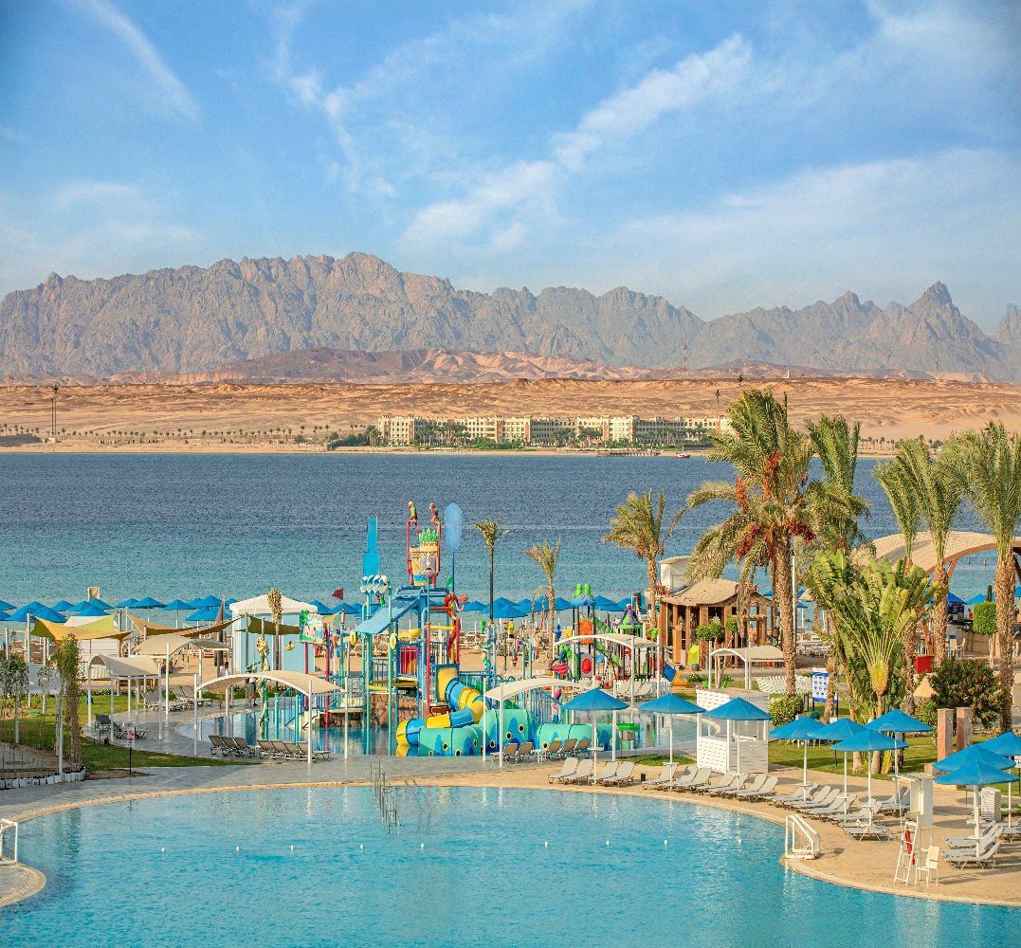
Location
Distance from
Hurghada Airport
24 km
Hurghada City Center
31 km
Senzo Mall
14 km
Hurghada Marina
34 km
Grand Aquarium Hurghada
17 km

Slide 5
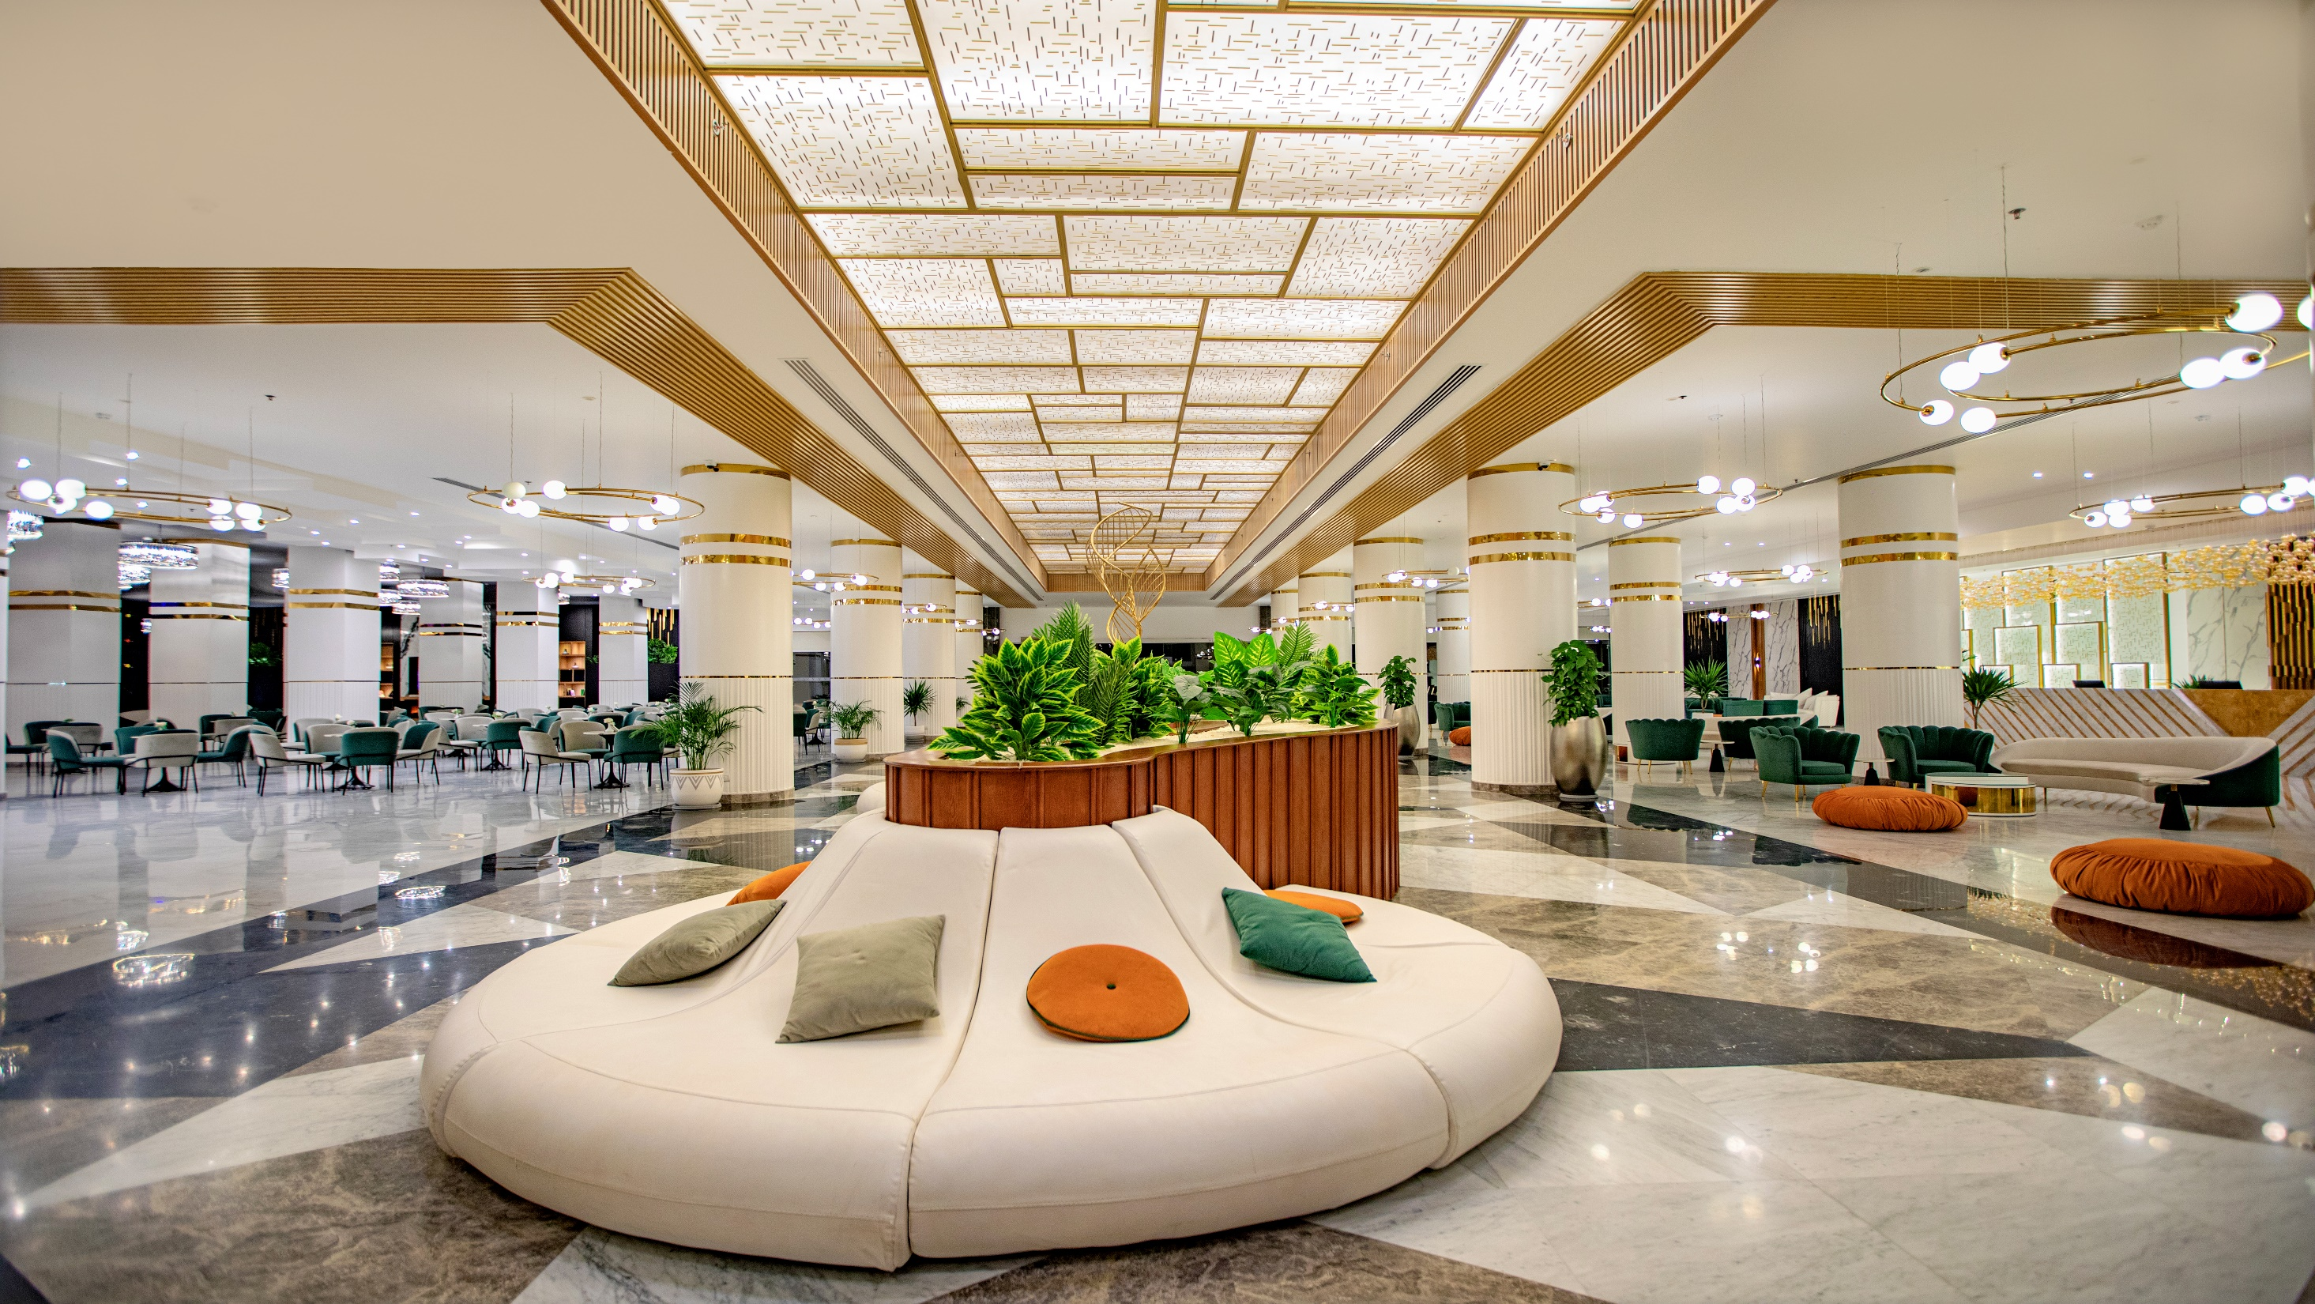
Accommodation
301 unites
Accommodation
301 unites

Slide 6
Room Type | View | No. Rooms | Size (m²) | Balcony | Description
The Panoramic Suite | Sea View | 6 | 57 m² | √ | Luxury suites spacious, and bright these richly-appointed 57 m², with stunning views of the iconic Sahl Hasheesh bay. The suite offers unmatched comfort and rich amenities.
Room Type | View | No. Rooms | Size (m²) | Balcony | Description
Penthouse Suite | Pool & Sea View | 12 | 72 m² + 25 m² Balcony | √ | Luxurious family suites with 2 bedrooms, in 2 different levels, 97 m² featuring unmatched amenities, living room with a dining area and large bathroom. Huge terrace where our guests can enjoy a direct panoramic view of the Red Sea, swimming pools, and greenery landscape.
Deluxe SV | Sea View | 63 | 44 m² | √ | Enjoy our elegant 44 m² guest rooms, designed and equipped with all the necessities to make your stay comfortable, tailored to the needs of leisure and business travelers alike, offering different views to for a tailor-made holiday experience.
Deluxe PV & Side SV | Pool & Side Sea View | 99 | 44 m² | √
Deluxe GV | Garden View | 30 | 44 m² | √

Slide 7
Room Type | View | No. Rooms | Size (m²) | Balcony | Description
Deluxe Swim-up Rooms | Pool View | 16 | 44 m² | x | Enjoy our elegant 44 m² guest rooms, designed in warm tones and tailored to the needs of private and business travelers, impress with a wonderful views
Superior Rooms | Sea View | 26 | 40 m² | √ | Enjoy our elegant 40 m² guest rooms, designed in warm tones and tailored to the needs of private and business travelers, impress with a wonderful views
Superior Rooms | Garden or Pool View | 47 | 40 m² | √

Slide 8
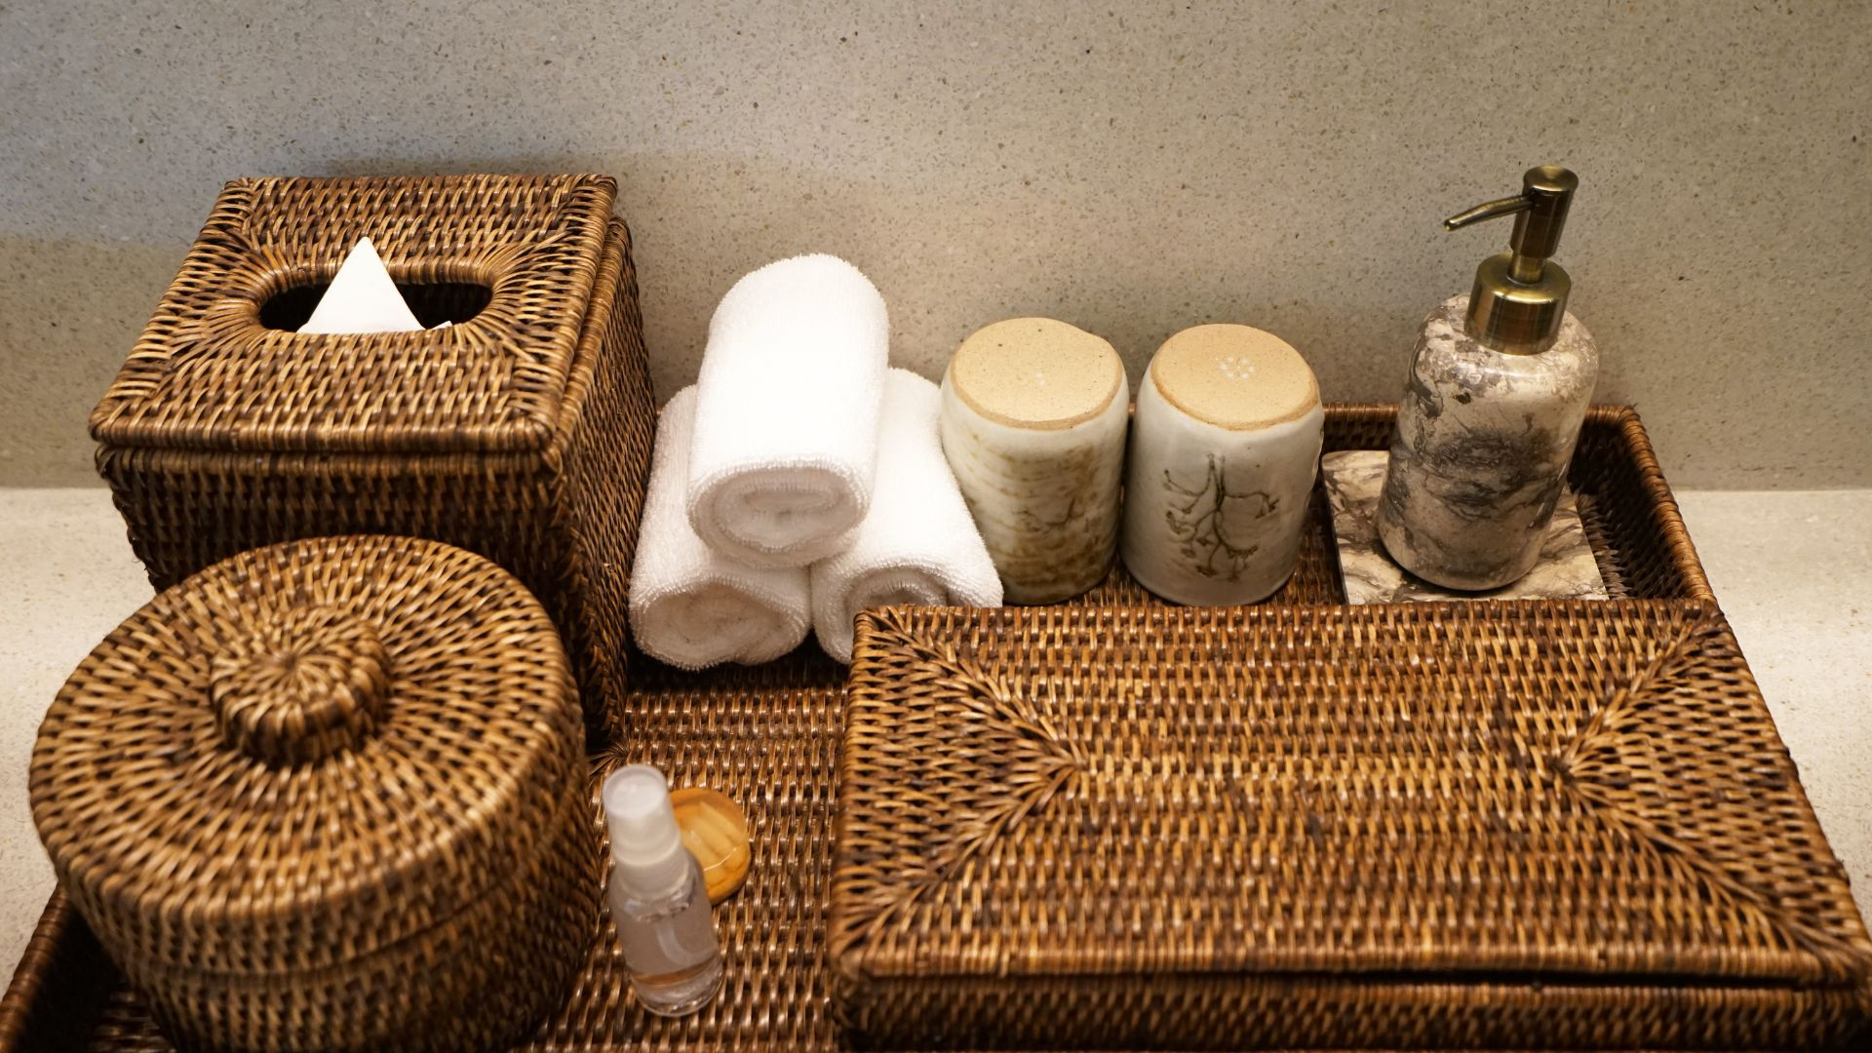
Room amenities

Slide 9
 | Superior Room | Deluxe Room | Deluxe Swim-up Room | Family Suite | The V Panoramic Suite | Penthouse
King Bed | King or Two Twin Beds | King or Two Twin Beds | King or Two Twin Beds | √ | √ | √
Make-Up mirror | √ | √ | √ | √ | √ | √
Bath shower | √ | √ | √ | √ | √ | √
Hairdryer | √ | √ | √ | √ | √ | √
Premium bathroom amenities | √ | √ | √ | √ | √ | √
High-Speed wireless internet | √ | √ | √ | √ | √ | √
LED TV | √ | √ | √ | √ | √ | √

Slide 10
 | Superior Room | Deluxe Room | Deluxe Swim-up Room | Family Suite | The V Panoramic Suite | Penthouse
Mini-Bar | √ | √ | √ | √ | √ | √
Water kettle | √ | √ | √ | √ | √ | √
Complimentary coffee and tea selection | √ | √ | √ | √ | √ | √
Complimentary water (Refreshed daily) | √ | √ | √ | √ | √ | √
Individual air conditioning control | √ | √ | √ | √ | √ | √
Housekeeping service | √ | √ | √ | √ | √ | √

Slide 11
 | Superior Room | Deluxe Room | Deluxe Swim-up Room | Family Suite | The V Panoramic Suite | Penthouse
24-Hour room service | √ | √ | √ | √ | √ | √
Laundry service (Dry cleaning is not included ) | √ | √ | √ | √ one Laundry bag free of charge once per stay | √ one Laundry bag free of charge once per stay | √ one Laundry bag free of charge once per stay
Complimentary bottle of wine upon arrival | _ | _ | _ | √ | √ | √
Capsule coffee mate | _ | _ | _ | √ | √ | √
Natural herbs | _ | _ | _ | √ | √ | √

Slide 12
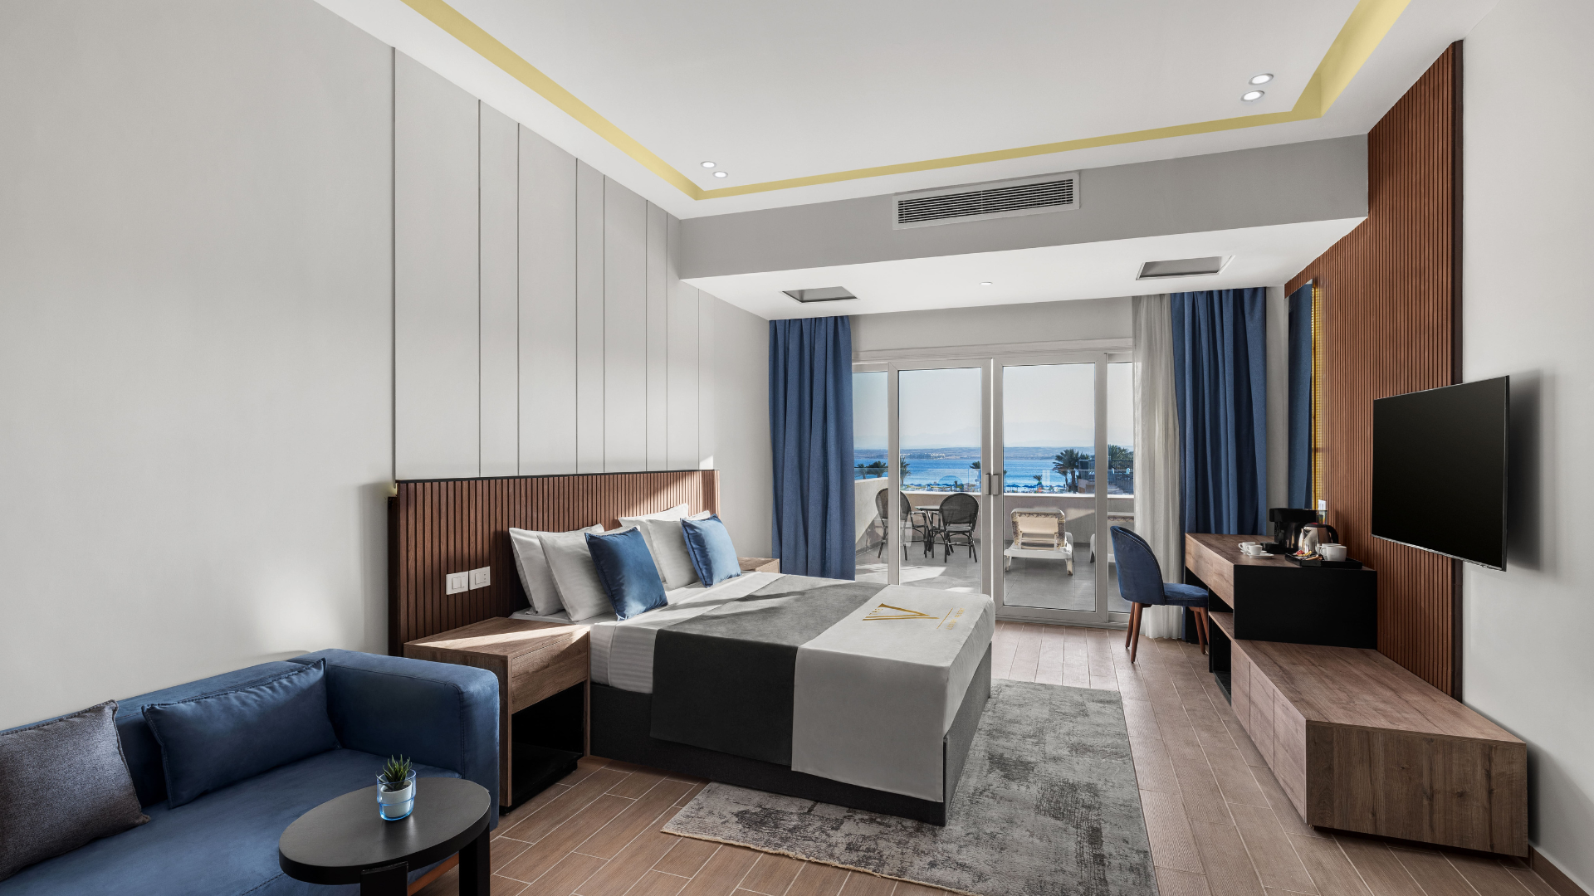
Room Description
301 unites

Slide 13
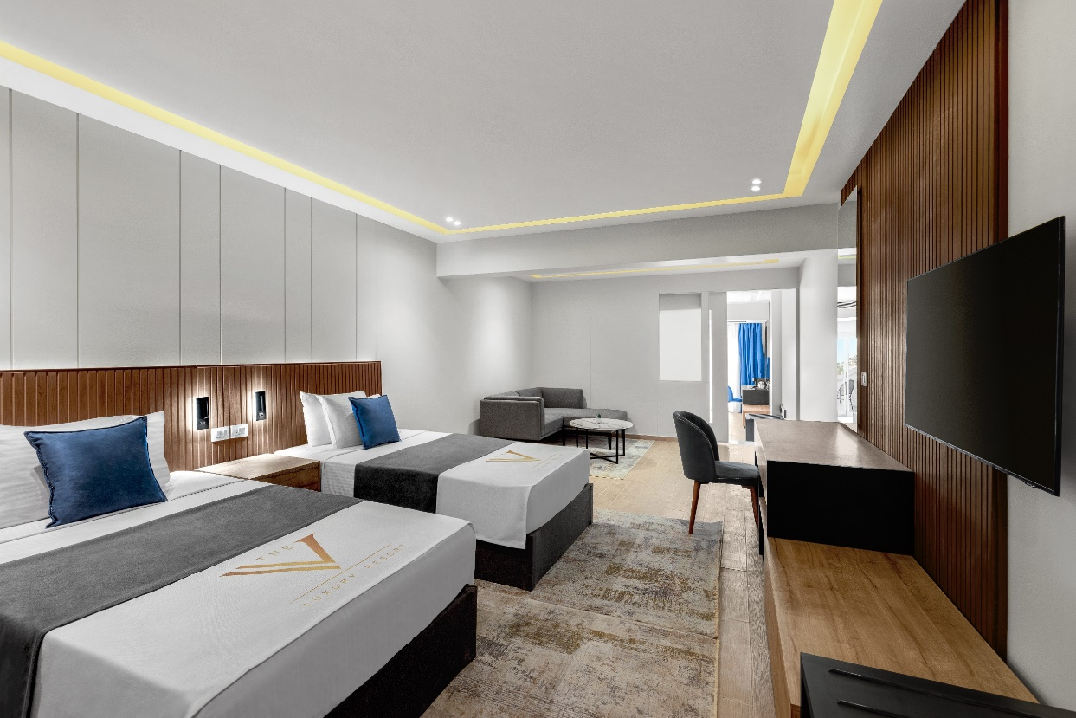
Penthouse Suite SV
Pool & Sea View
Number of unites: 12
Size: 72 m²+ 25 m² Balcony
Specifications:
Luxurious family suites with 2 bedrooms, in 2 different levels, 97 m² that features by upgraded amenities, a living room with a dining area and large bathroom. Huge terrace where our guests can enjoy a direct panoramic view of the Red Sea, swimming pools, and landscape gardens.

Slide 14
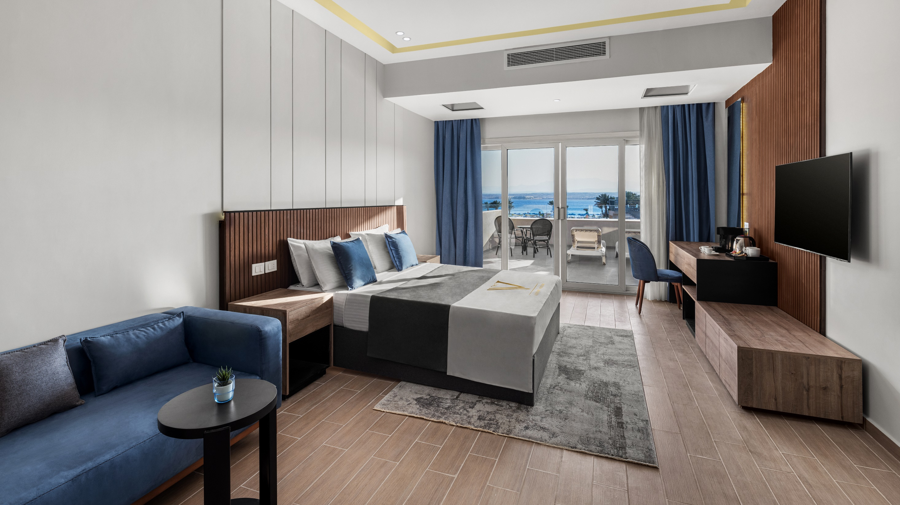
Penthouse Suite SV

Slide 15
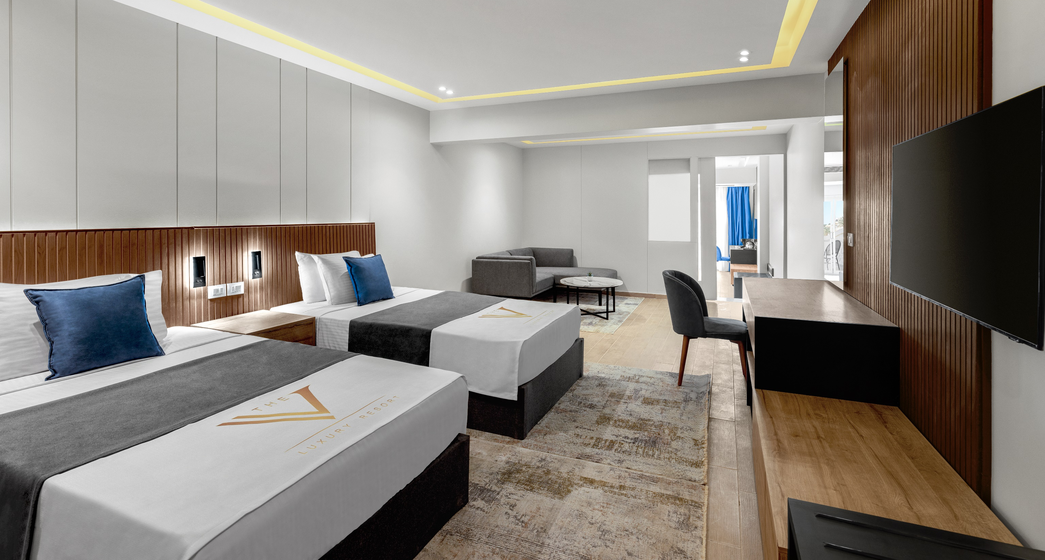
Penthouse
Penthouse Suite SV

Slide 16
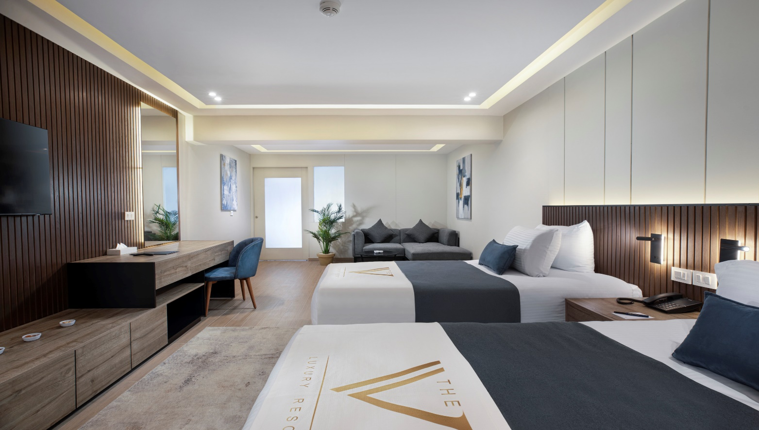
Family Suite
Sea View
Number of unites: 2
Size: 55 m² + 20 m² Balcony
Specifications:
Luxury family rooms occupying the higher floors of the hotel and measuring 75 m². Guests can enjoy unparalleled level of service, taking luxury and comfort to another level.

Slide 17
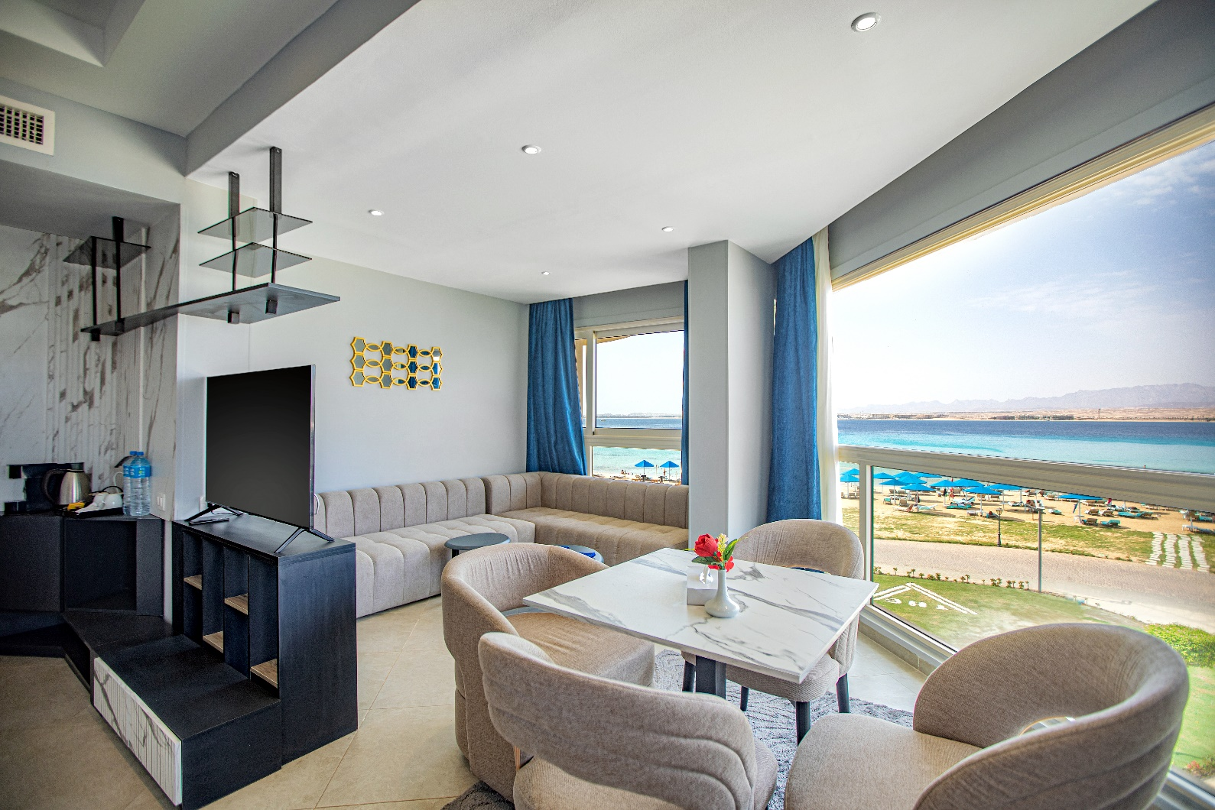
The Panoramic Suite
Sea View
Number of units: 6
Size: 57 m²
Specifications:
Luxury suites spacious, and bright these richly-appointed 57 m², with stunning views of the iconic Sahl Hasheesh bay.
The suite offers unmatched comfort and rich amenities.

Slide 18
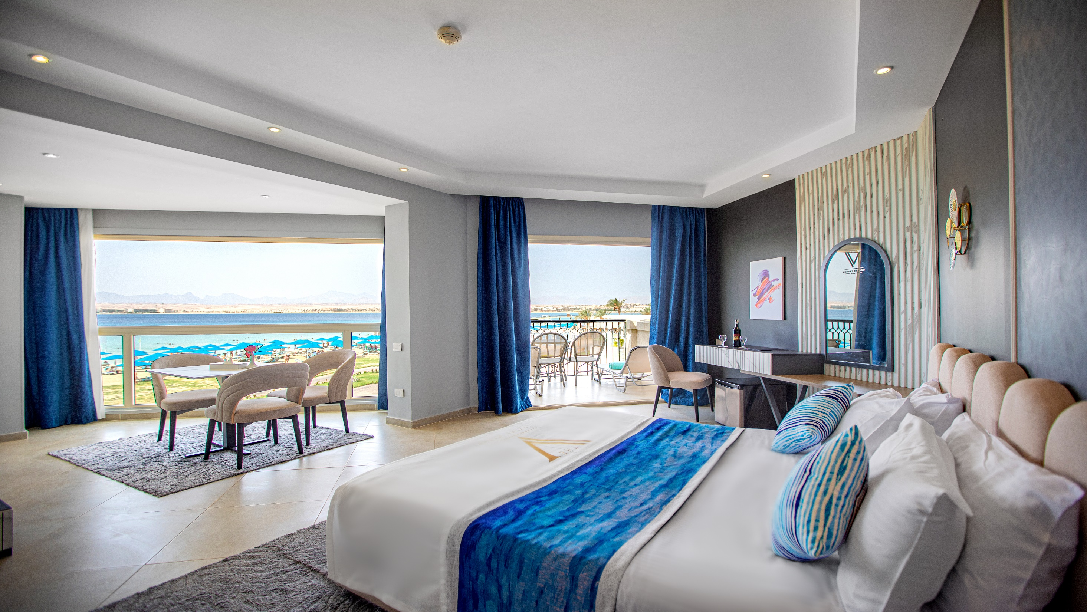
The Panoramic Suite

Slide 19
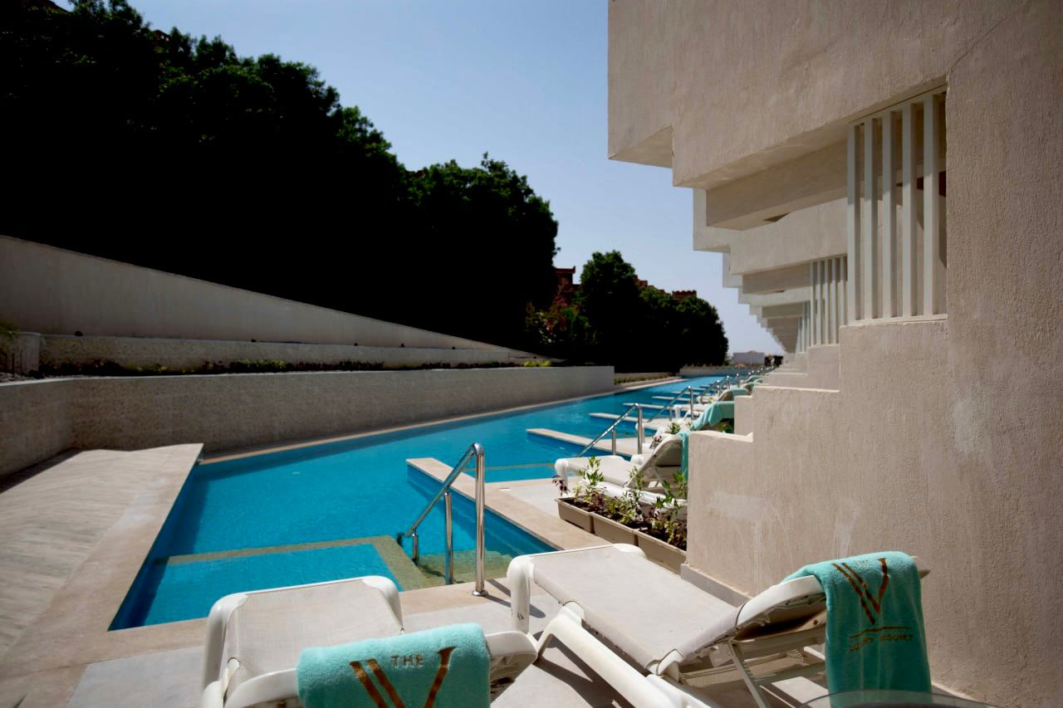
Deluxe Swim-up Room
Pool View
Number of Units : 16
Size: 44 m²
Specifications:
Elegantly furnished 44 m² guest rooms, with direct access to the pool area from your terrace designed in warm tones and tailored to the needs of leisure and business travelers.

Slide 20
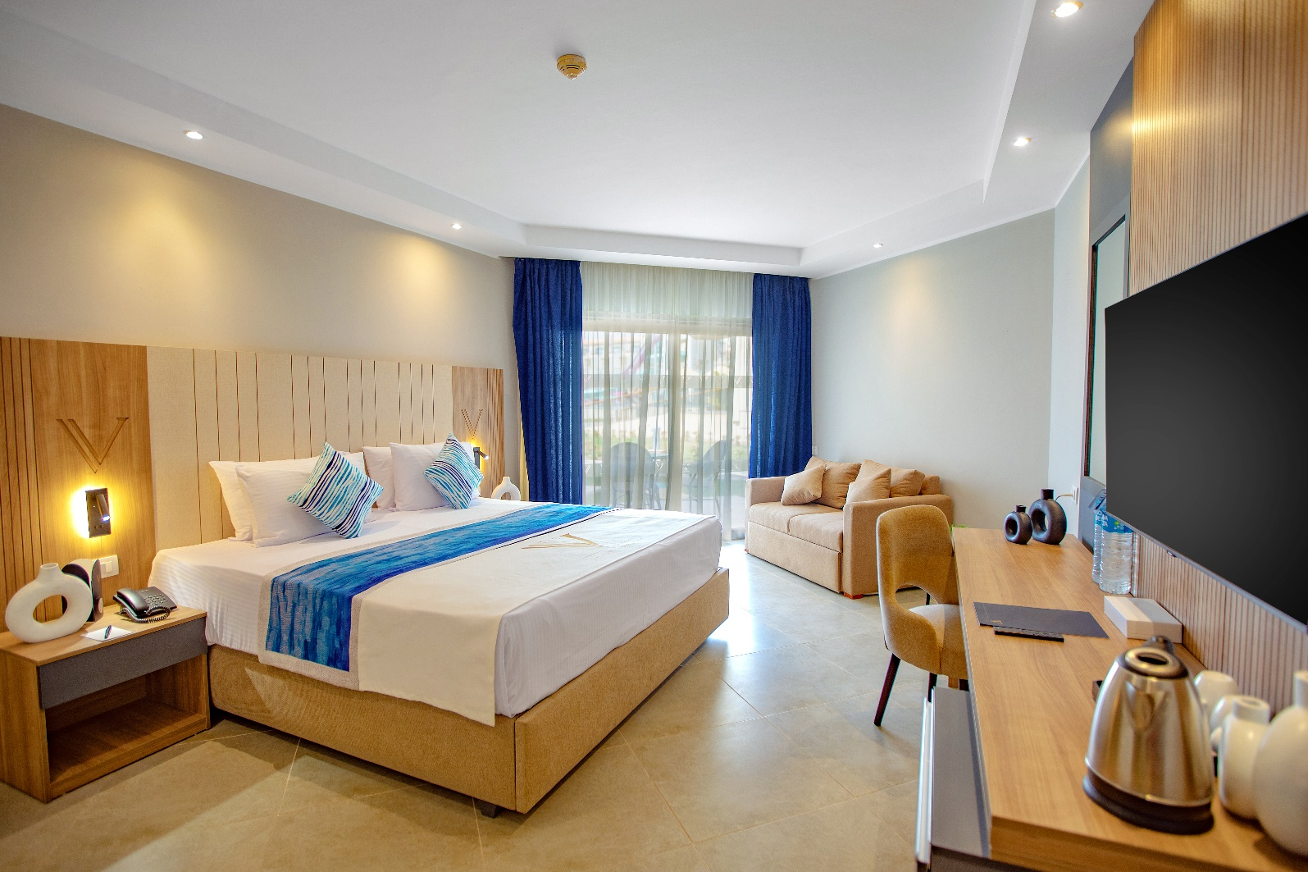
Deluxe Room
Different Views
(Sea View/Pool View/Side Sea View/Garden View)
Number of Units :
Size: 44 m²
Specifications:
Elegantly furnished 44 m² guest rooms, designed in warm tones and tailored to the needs of leisure and business travelers, with different wonderful views.

Slide 21
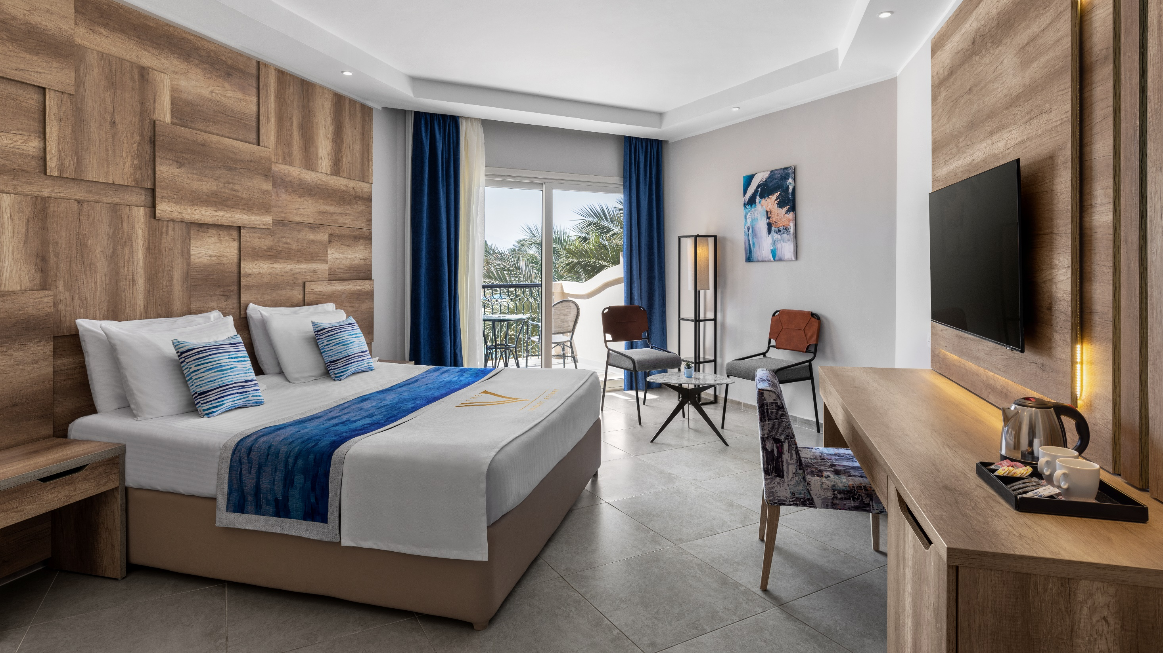
Deluxe Room

Slide 22
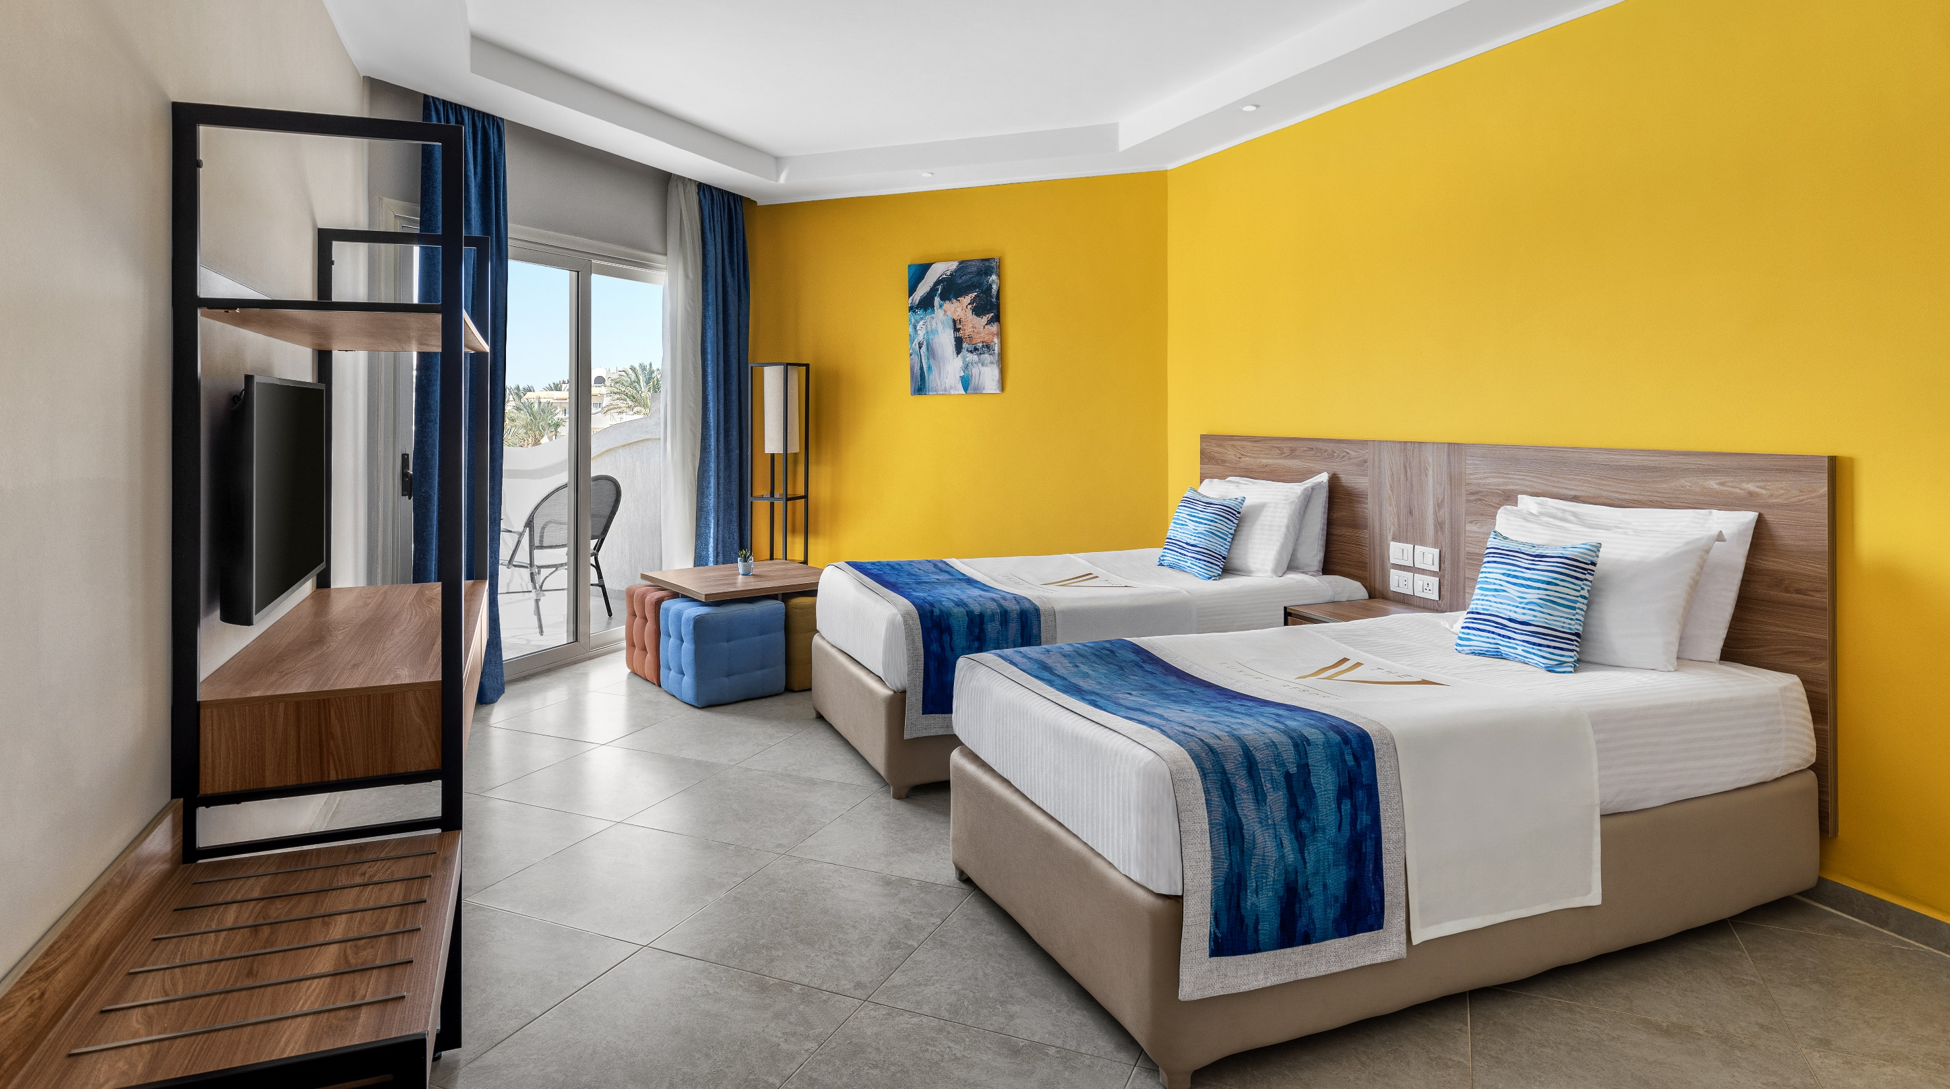
Deluxe Room

Slide 23
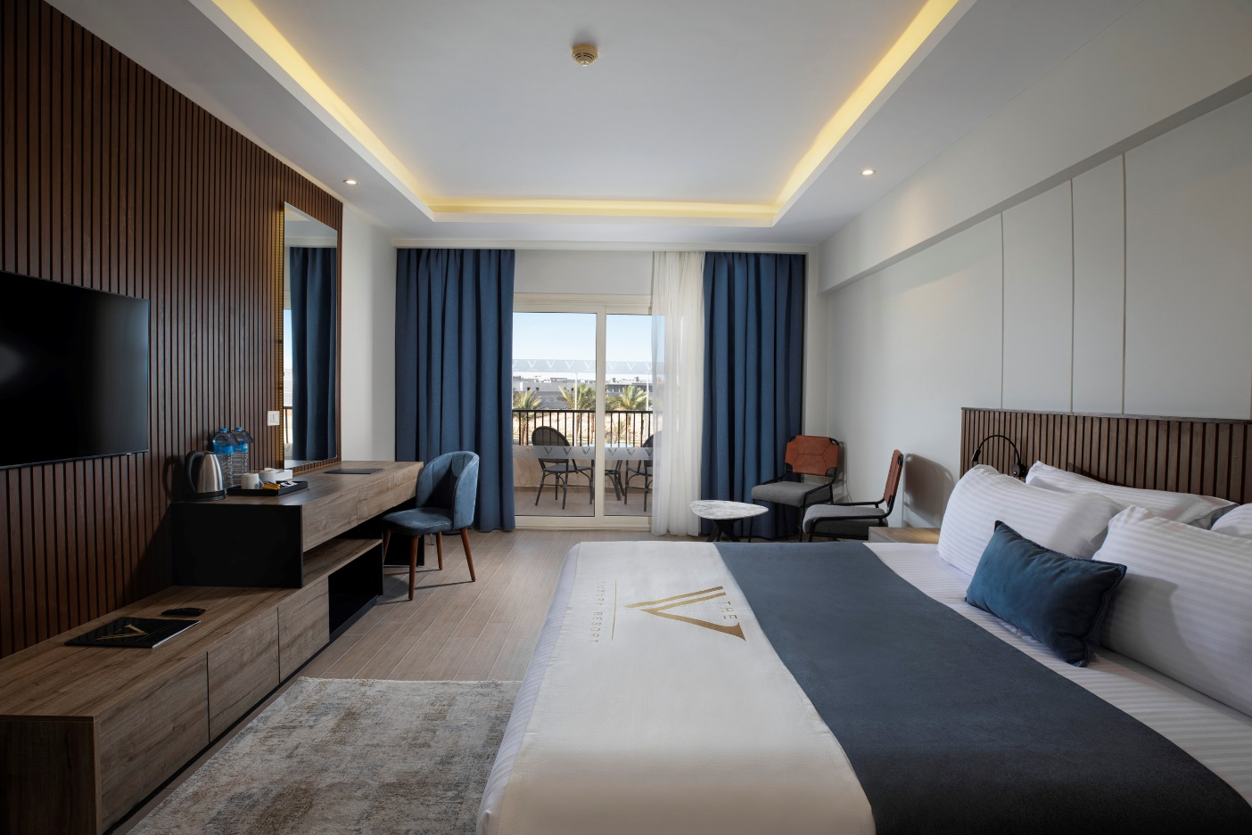
Superior Room
Different Views
(Sea View/Pool View/Garden View)
Number of Units : 74
Size: 40 m²
Specifications:
Elegantly furnished 40 m² guest rooms, designed in warm tones and tailored to the needs of leisure and business travelers, with different views.

Slide 24
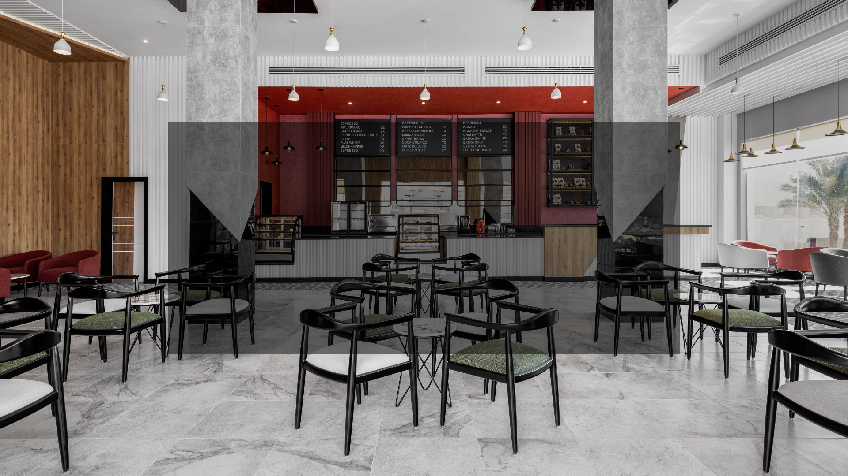
FOOD & BEVERAGE
SERVICES

Slide 25
The V’s Food & Beverage Outlets
Main Restaurant
Lobby Bar
Horizon Pool Bar
Sky Breeze Bar
Brew House Coffee Shop
Angles and Demons
Pican᷉a Beach Bar and A la Carte Restaurants
(Brazilian Restaurant and Beach Bar)

Slide 26
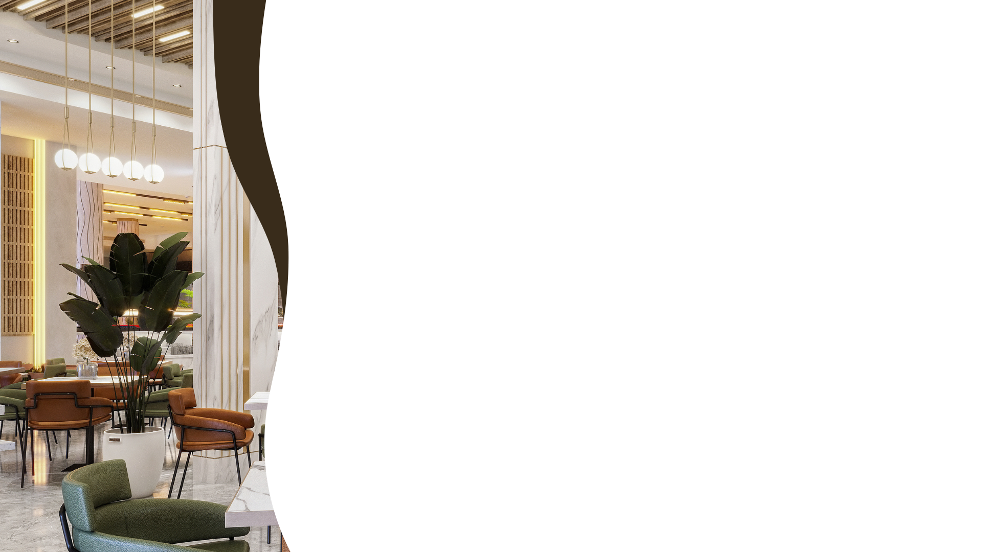
Seven Senses Main Restaurant
Our main restaurant is an all-day dining concept that tantalizes the senses with an exceptional culinary experience. Indulge in an extensive array of options where The V brings you 7 cuisines in two spacious and elegant dining rooms. At The V, you can find your favorite picks from Italian, Greek, Turkish, Oriental, Chinese, Japanese, and Indian cuisines.
Special delicacies for children are available in the kid’s corner located in the Main Restaurant.
Operation hours: Breakfast: 07:00 – 10:00
Late breakfast: 10:00 – 11:00
Lunch: 12:30 – 15:00
Snack: 15:30 – 17:00
Dinner: 18:00 – 22:00
Late dinner: 22:30 – 01:00
Light breakfast buffet: 01:00 – 06:00

Slide 27
Pican᷉a - Brazilian Restaurant and Beach Bar
Explore the rich flavors of Latin cuisine with premium grills perfectly marinated and delicately prepared and cooked the Brazilian way.
The beach bar serves light continental breakfast, fresh juices, and croissants for a great start for the day by the beach.
Operation hours:
Daily from 18:00 to 22:00
Beach Bar is open daily from 06:00 to 00:00

Slide 28
Angels and Demons
Bringing the best of both worlds, Angels and Demons is an exceptional dining experience catering to diners on a plant- based diet as well as others who want to give their taste buds a treat with guilty pleasure. At Angels and Demons, we make it easier for vegetarians, vegans, and pescatarians to choose from a variety of delectable dishes that fit within their diets. Our chefs will also satisfy the cravings of diners who want to rejoice with delicious pizzas, burgers, succulent desserts, and a lot more.
Operation hours:
Daily till midnight

Slide 29
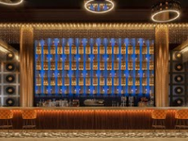
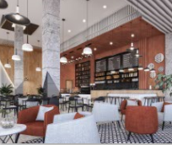
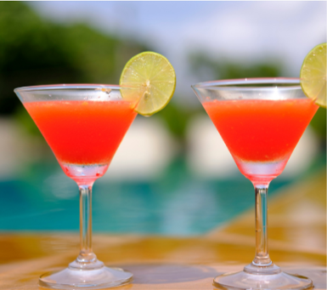
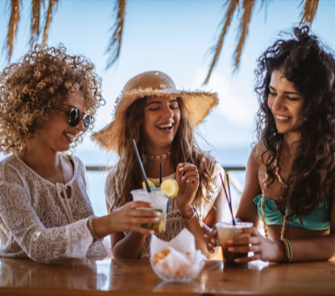
NO PHOTO FOR SKY BREEZE
LOBBY BAR
BREW HOUSE
COFFE SHOPE
HORIZON
POOL BAR
SKY BREEZE
Operation hours: Around the clock
Operation hours :
Daily from 08:00 to 00:00
Operation hours: From morning till sunset
Operation hours:
From xx:xx to xx:xx

Slide 30
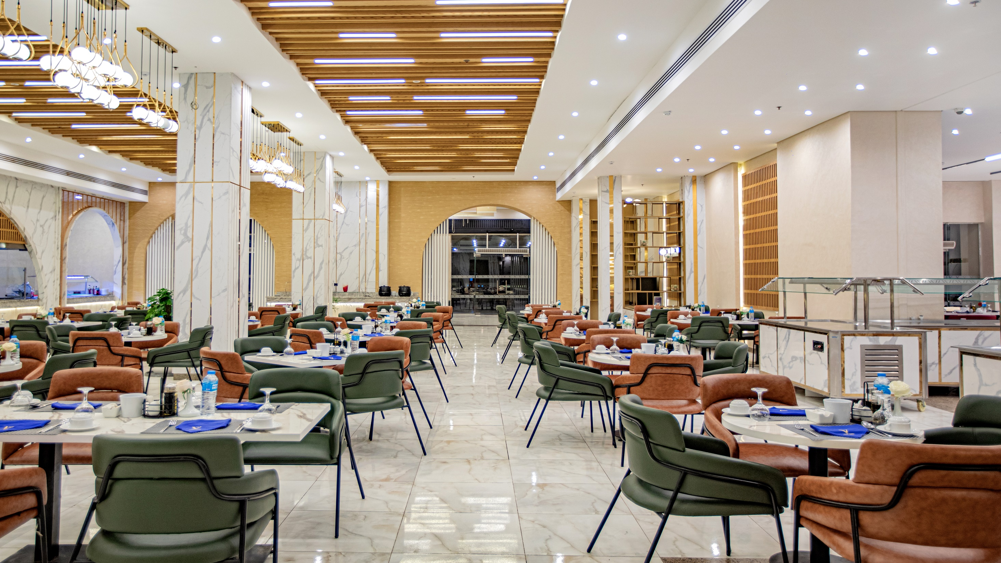
Seven Senses Main Restaurant
Seven Senses Main Restaurant

Slide 31
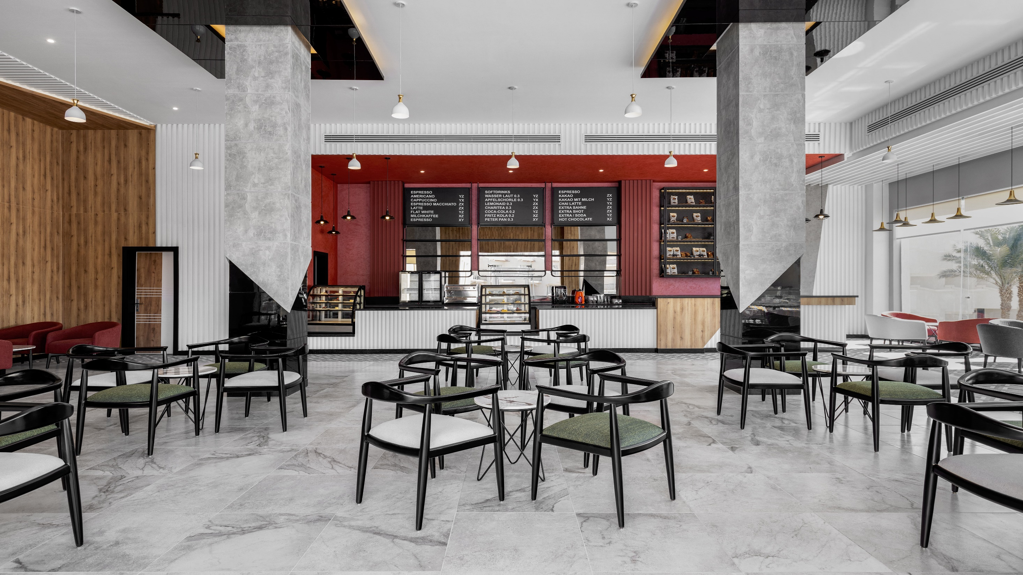
Brew House Coffee Shop

Slide 32
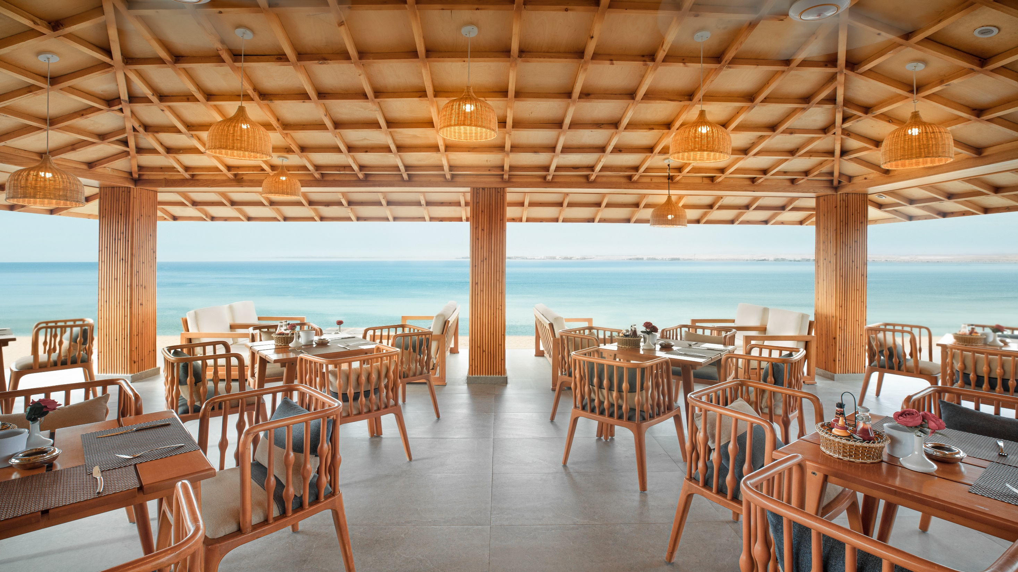
Pican᷉a Brazilian Restaurant &
Beach Bar
Pican᷉a Brazilian Restaurant &
Beach Bar

Slide 33
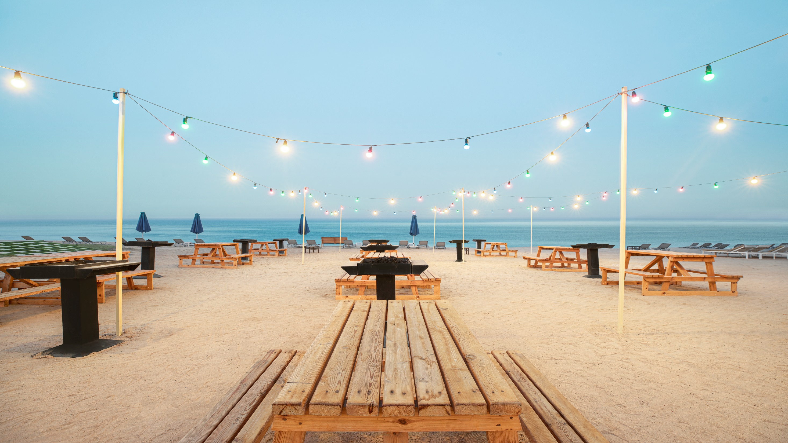
UCook

Slide 34
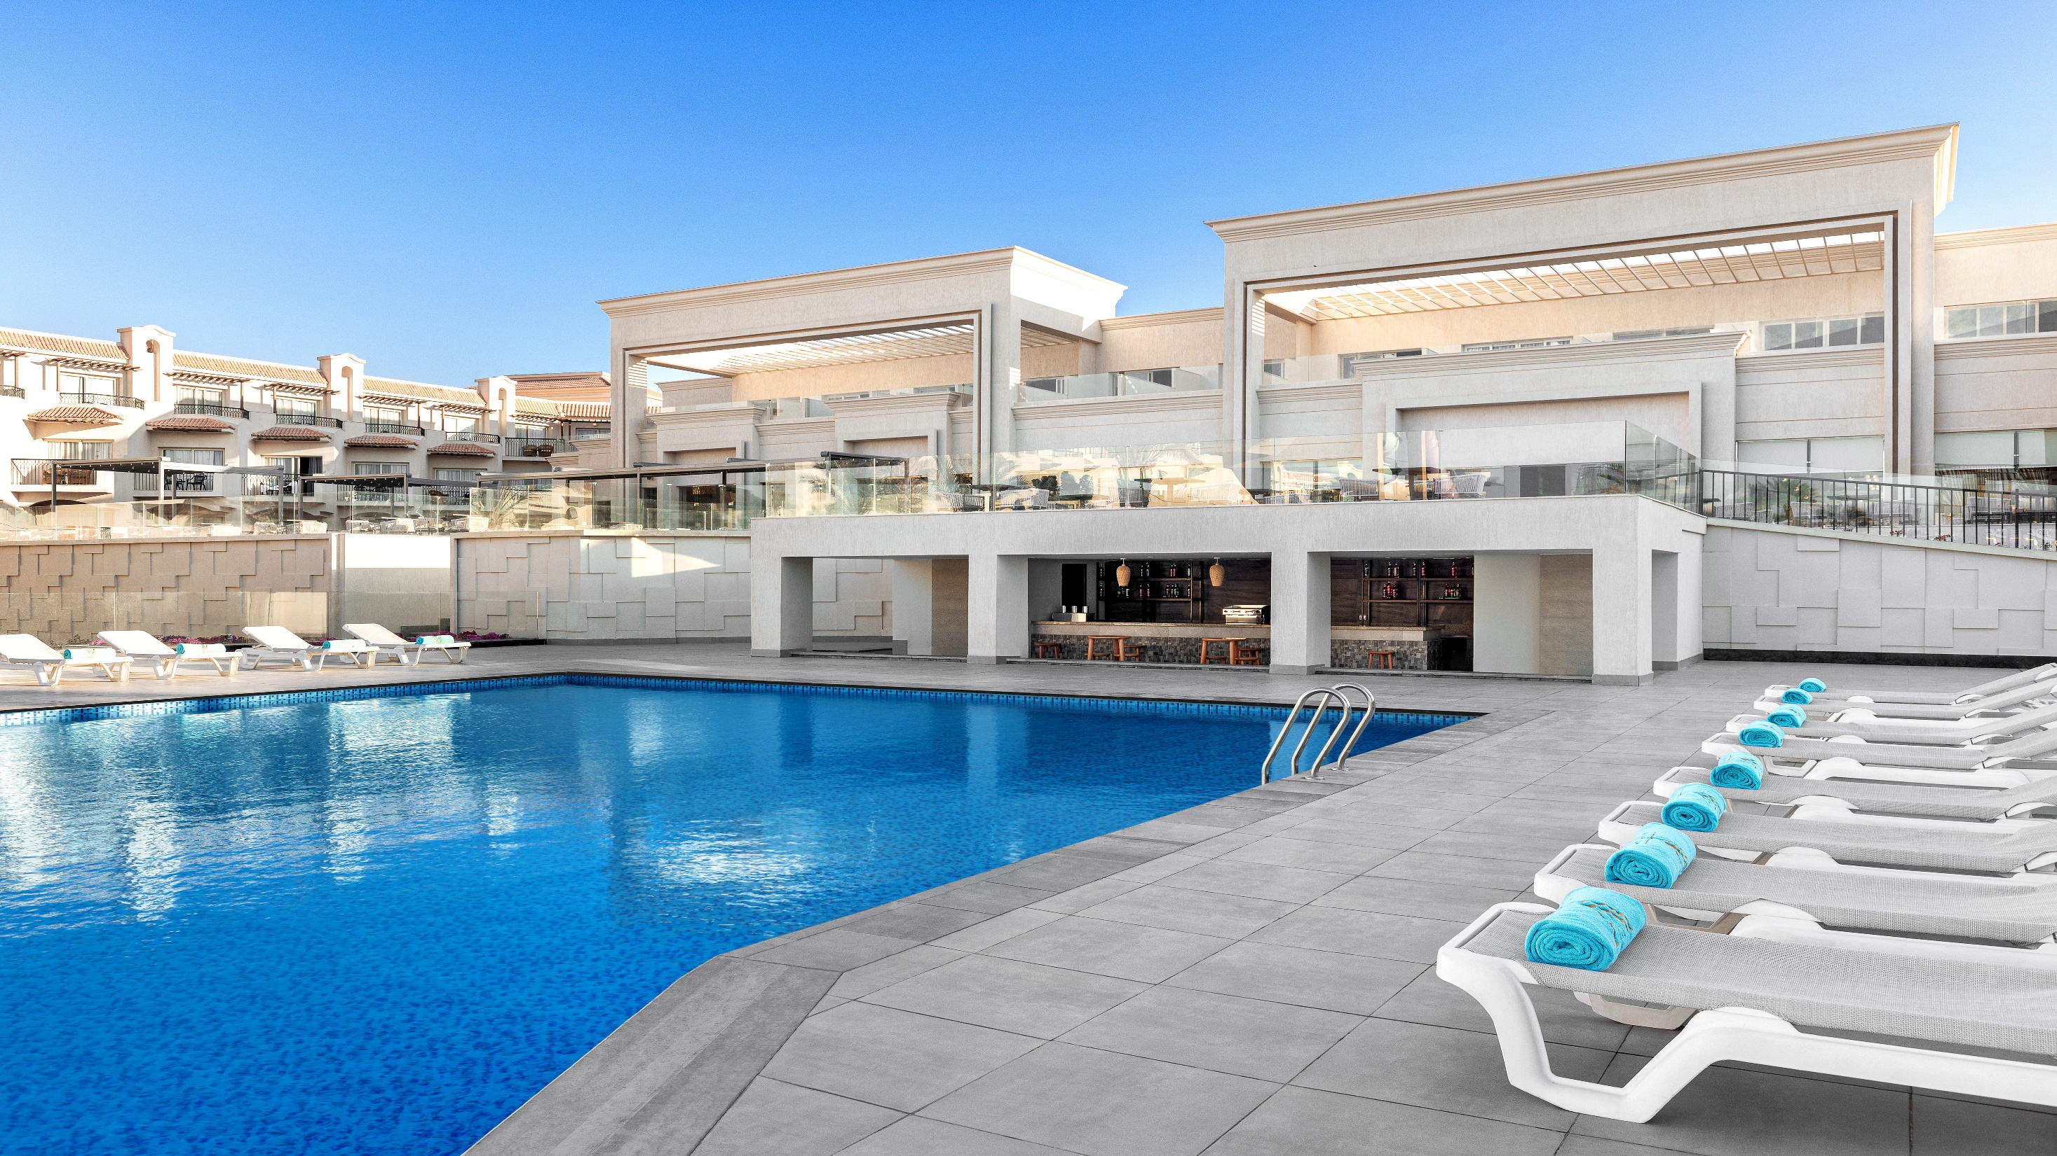
Horizon Pool Bar

Slide 35
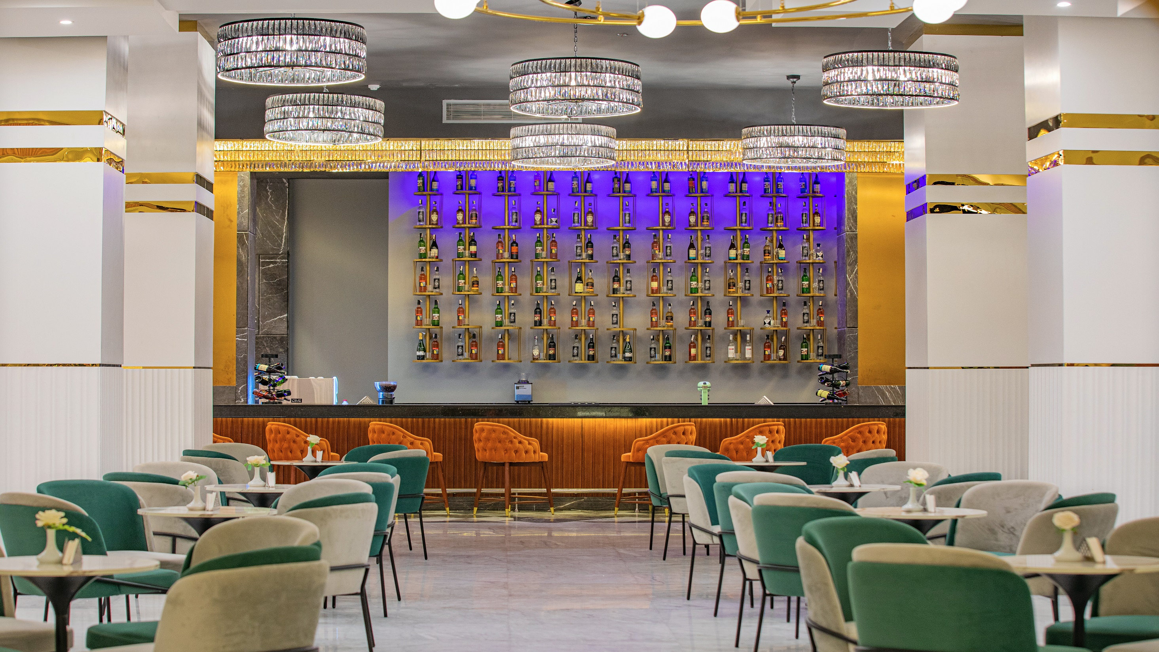
Lobby Bar

Slide 36
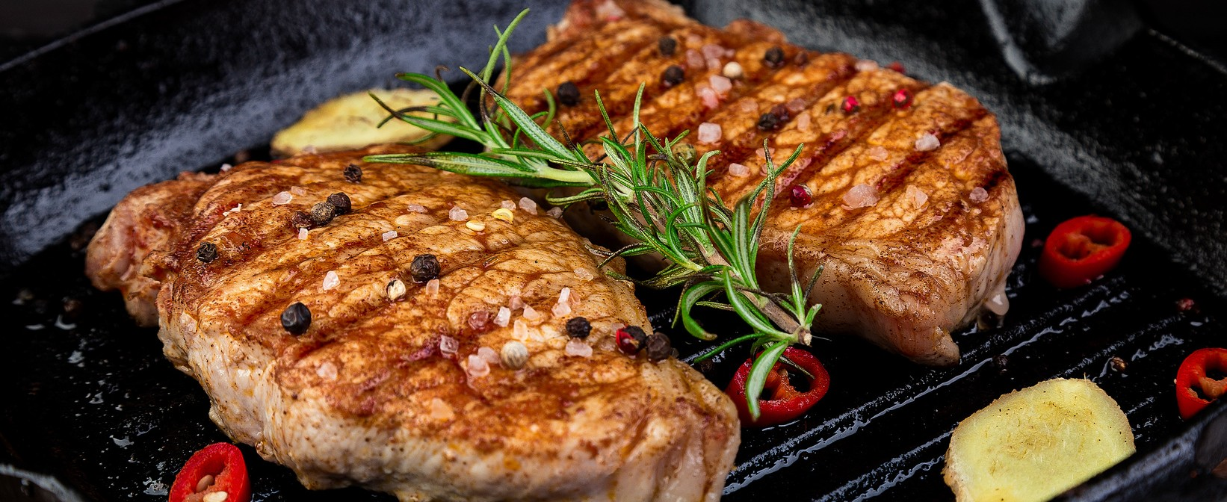
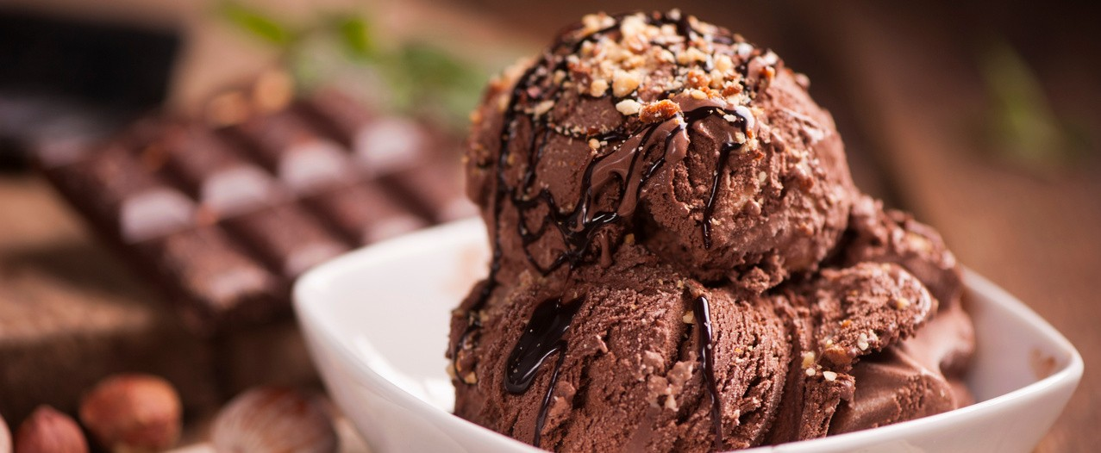
FOOD & BEVERAGE CONCEPT
This services are based on the custommer preferences with a prior request made through the Butler Service Team

Slide 37
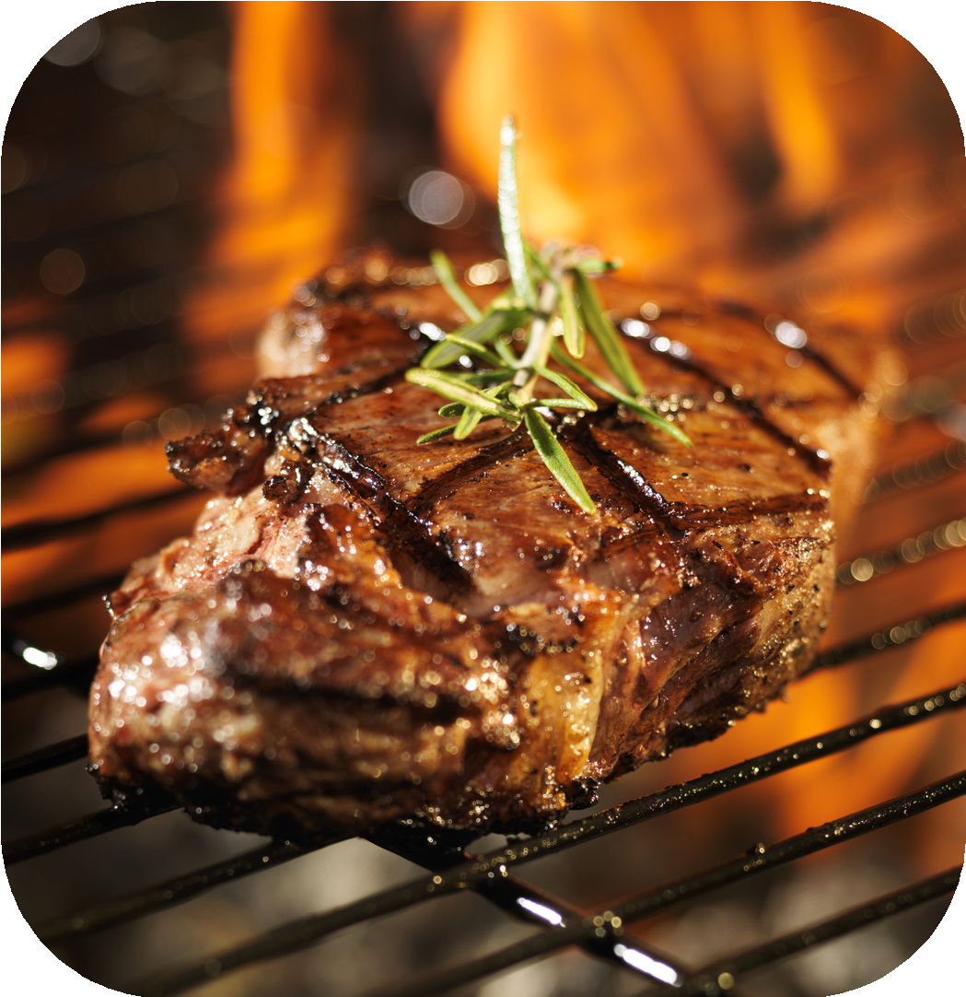
U-cook
By prior arrangement and assistance of our Butler Team, guest can choose the Items to grill on charcoal, having it cooked in a delightful BBQ experience at the beach. To ensure a great taste and quality, the food will be preserved and delivered in an icebox ready to be cooked.

Slide 38
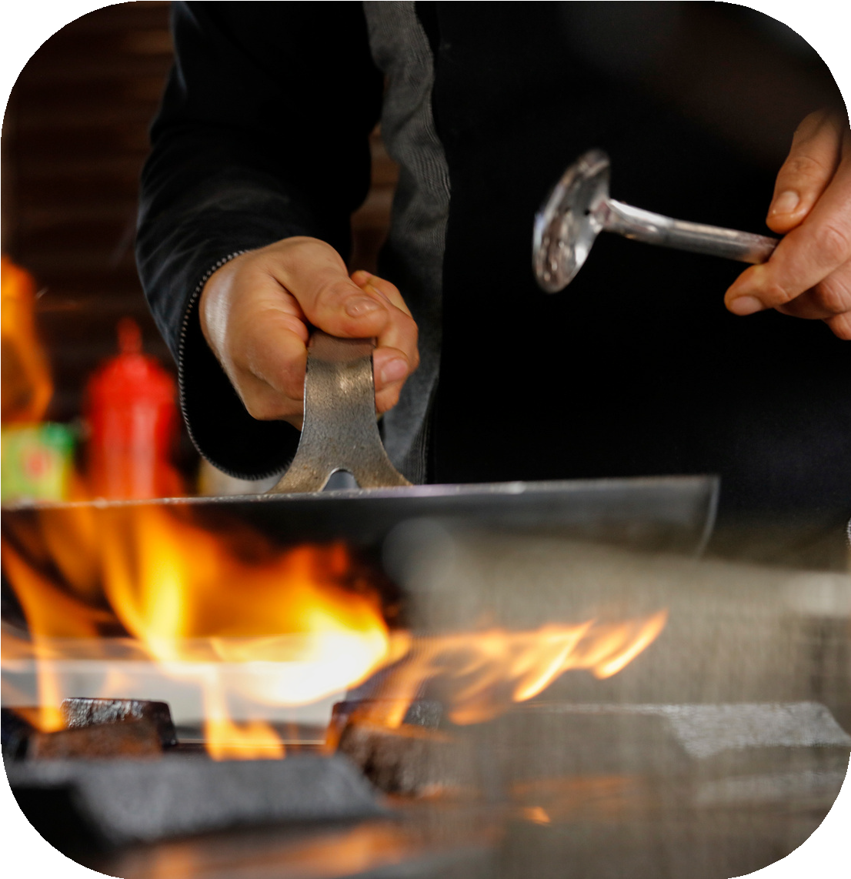
Flambé Trolley
By prior arrangement with our Butler Team (flambé trolley(. Guests can enjoy their meal at the terrace area, offering scrumptious food that pair perfectly with a lengthy drink list assisted by our food & beverage team.

Slide 39
Ultra V Concept
All Juices served in all outlets are fresh or packets
not powder juice
All served water is bottled no water dispensers
or Juice dispenser at all in all outlets
Only local premium wine is served
Only local premium alcoholic drinks
Either iced beer or normal cold beer with
minimum 4 brands
Most of fruits & vegetables which are served
in The V, are organic according to seasonality

Slide 40
The V guest have the opportunity to enjoy Pyramisa F&B outlets as well other services as follow:
F&B Outlets operation hours:
The Grind Café
Sunrise Pool Bar
Vienna Lobby Bar
Beach Bar
Beach Snack Service
Ice Cream Service
Cocktail Terrace Bar
Tea Coffee Time
10:00 – 00:00
08:00 – 00:00
10:00 – 17:00 (extra charge 18:00-22:00)
10:00 – 17:00
12:00 - 16:00
14:00 - 16:00
12:00 - 00:00
16:00 - 17:00

Slide 41
Six Continents Main Restaurant
Breakfast
Late Breakfast
Lunch
Dinner
Late Dinner
Light Breakfast Buffet
07:00 – 10:00
10:00 – 10:30
12:30 – 14:30
18:30 – 21:30
23:00 – 00:00
01:00 – 05:00

Slide 42
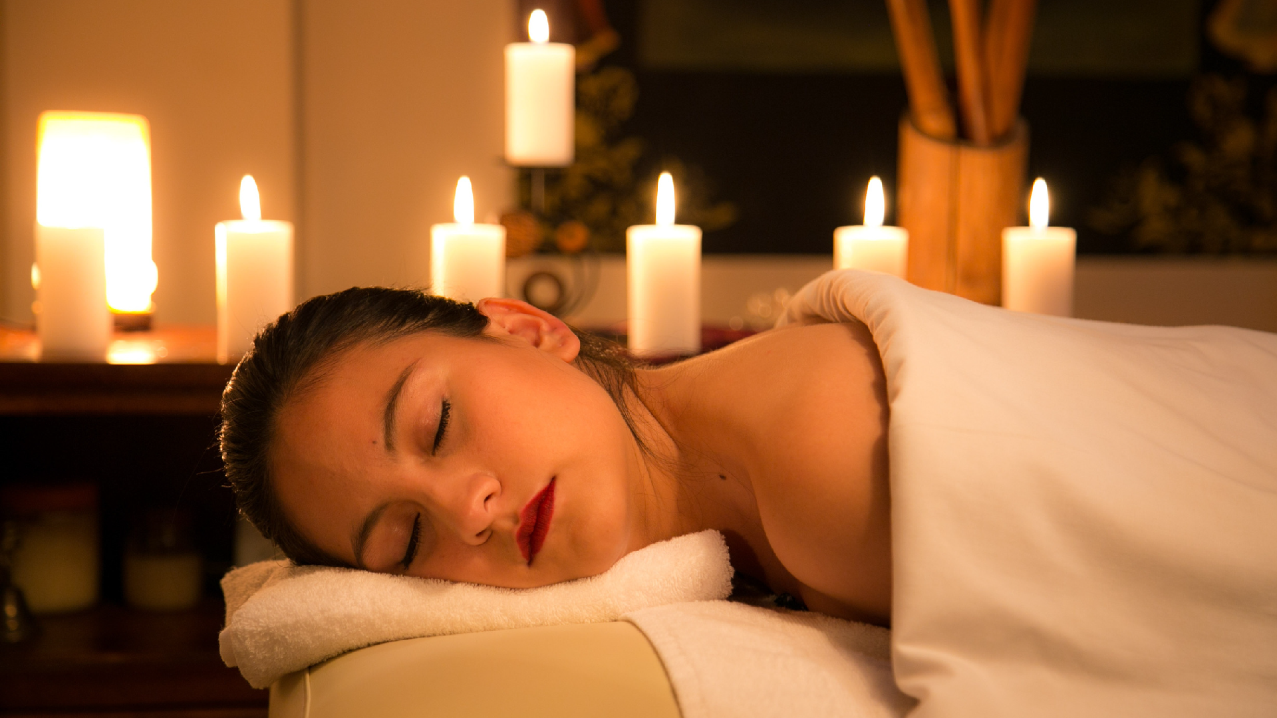
Wellness

Slide 43
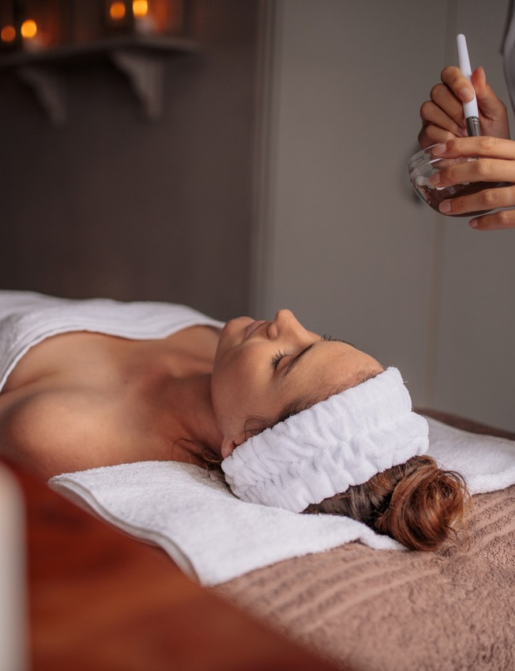
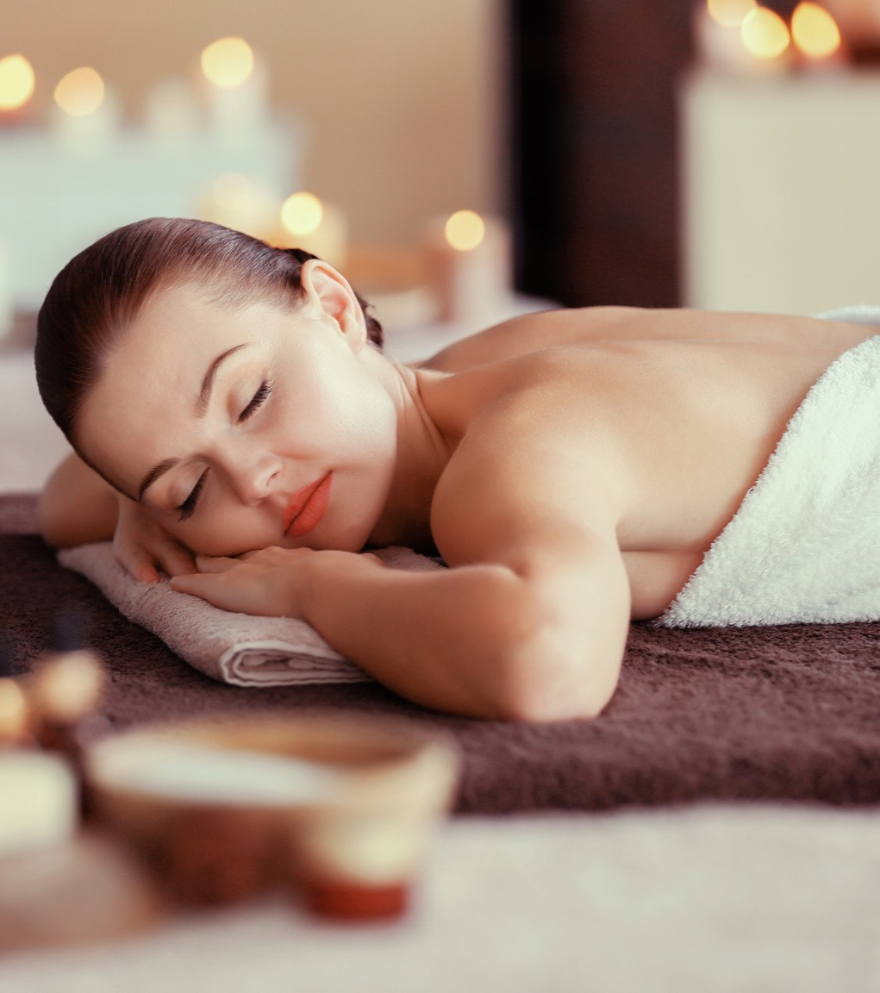
SPA
Relieve your tiredness with the massages offered by our professional SPA staff, and get rid of the tiredness of the year accumulated on your skin with skin care treatments. SPA Centre opening hours between 09:30- 18:30.

Slide 44
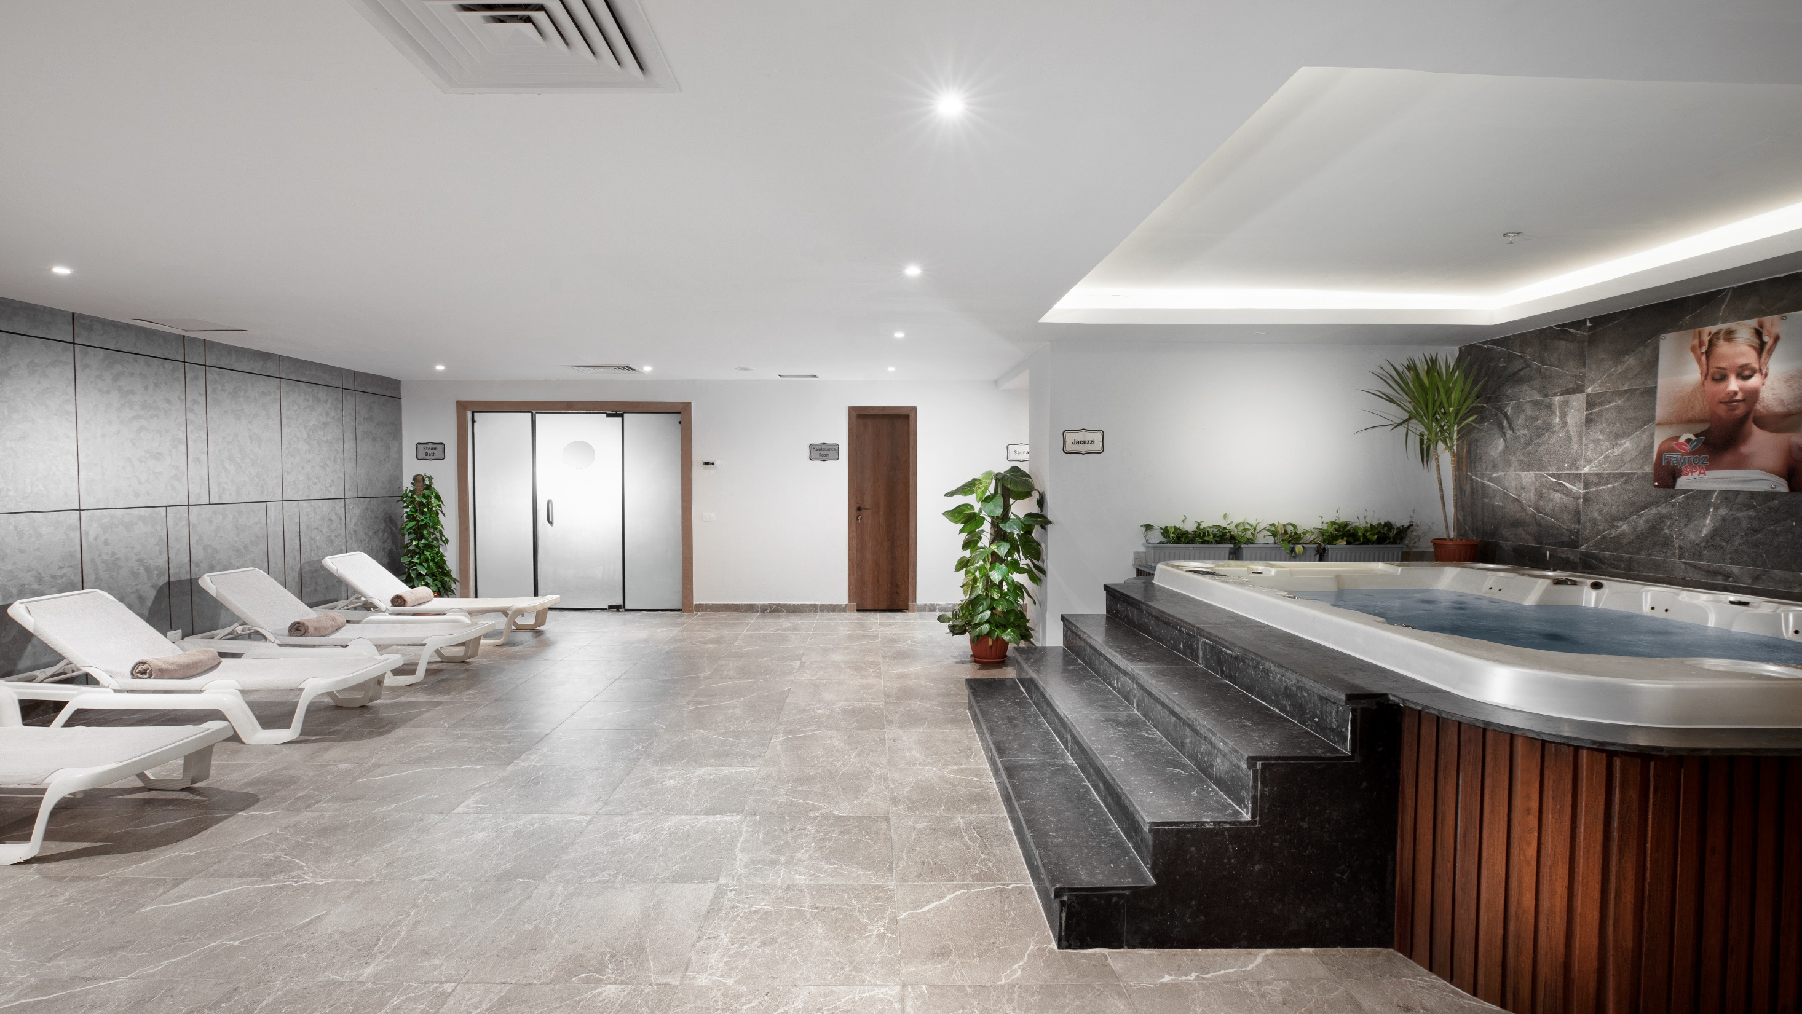

Slide 45
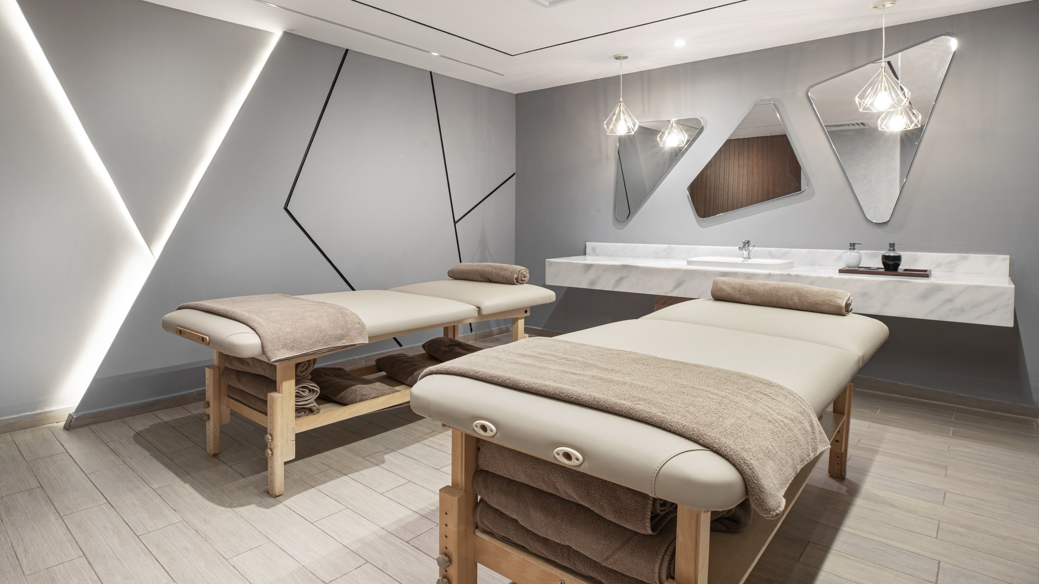

Slide 46
GYM
Free of charge, Techno Gym equipment for all guest above 16 years, opening time
09:00 – 18:00

Slide 47
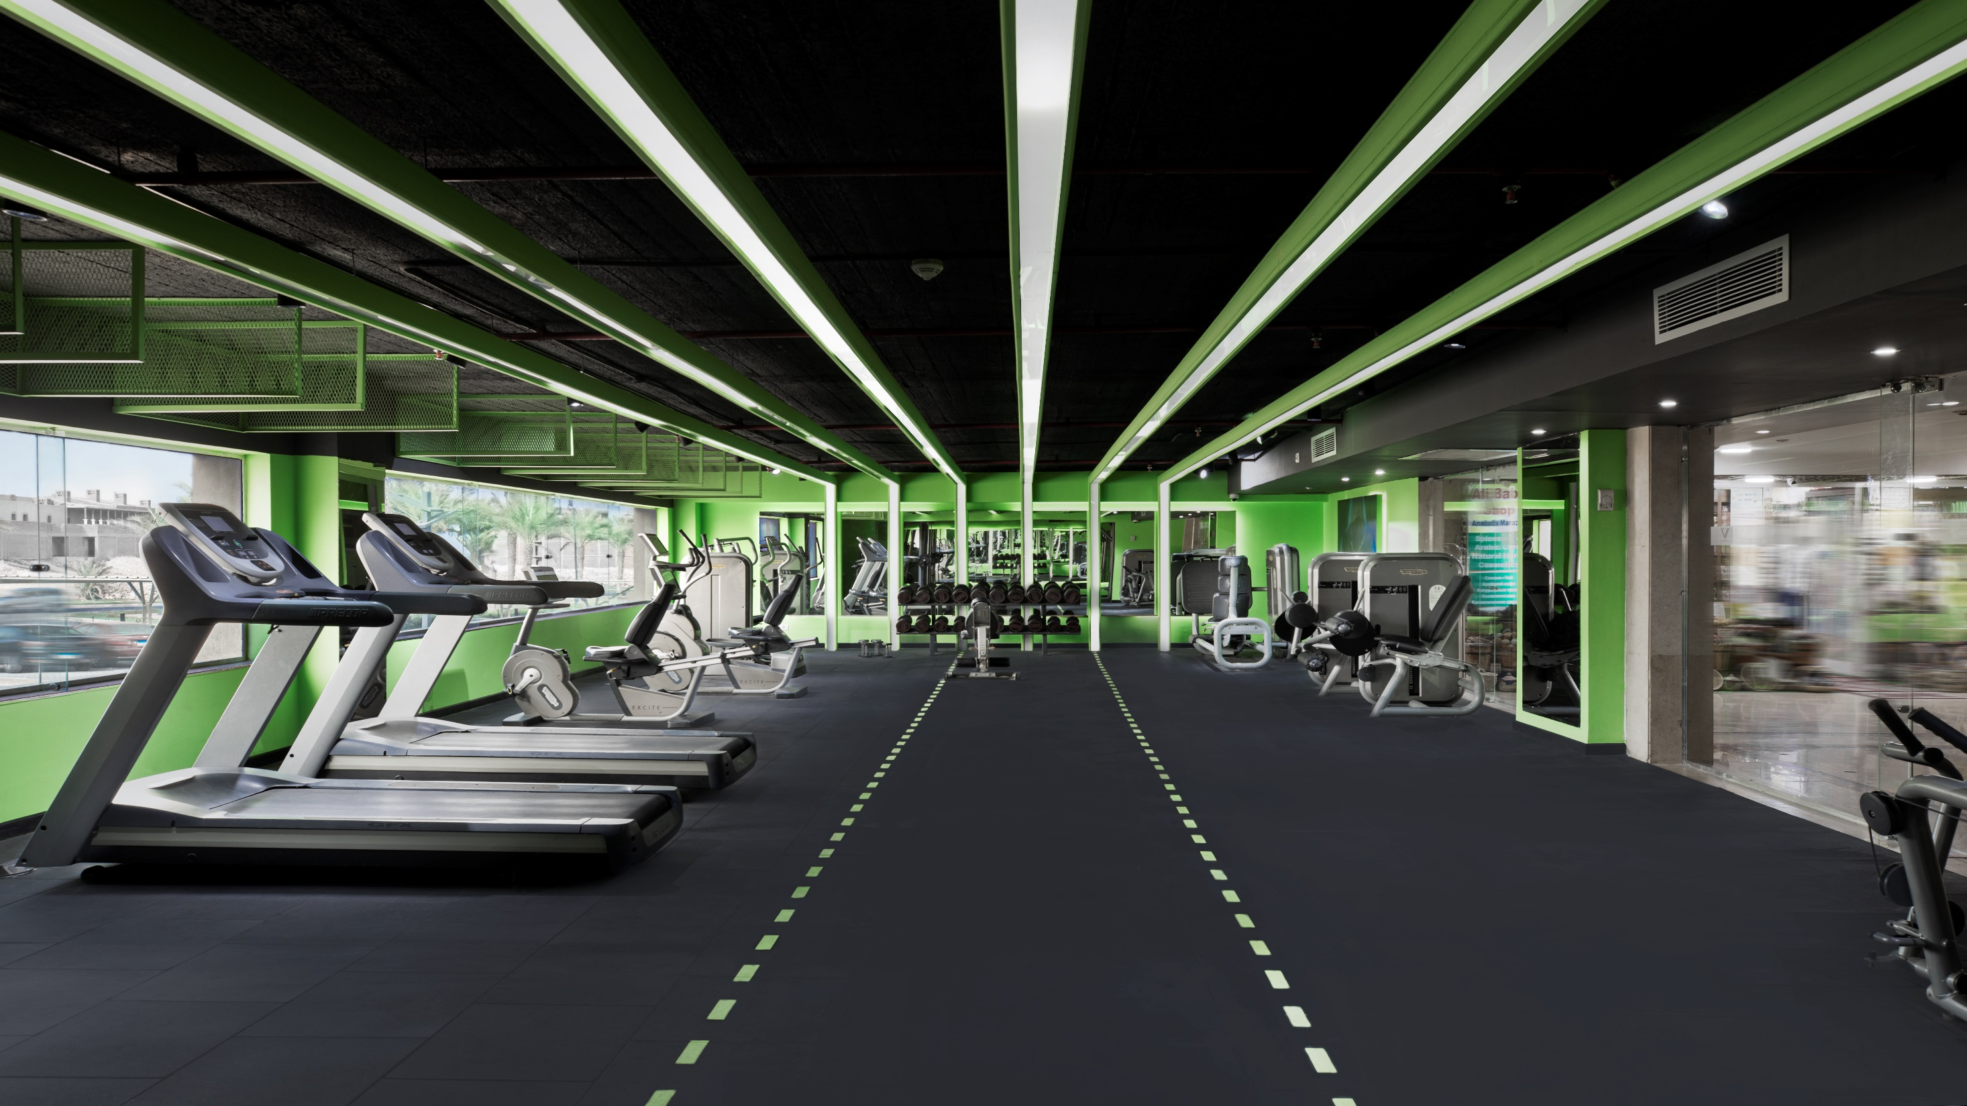

Slide 48
Beauty Salon & Hairdresser
Against extra charge, opening time
09:00 – 18:00

Slide 49
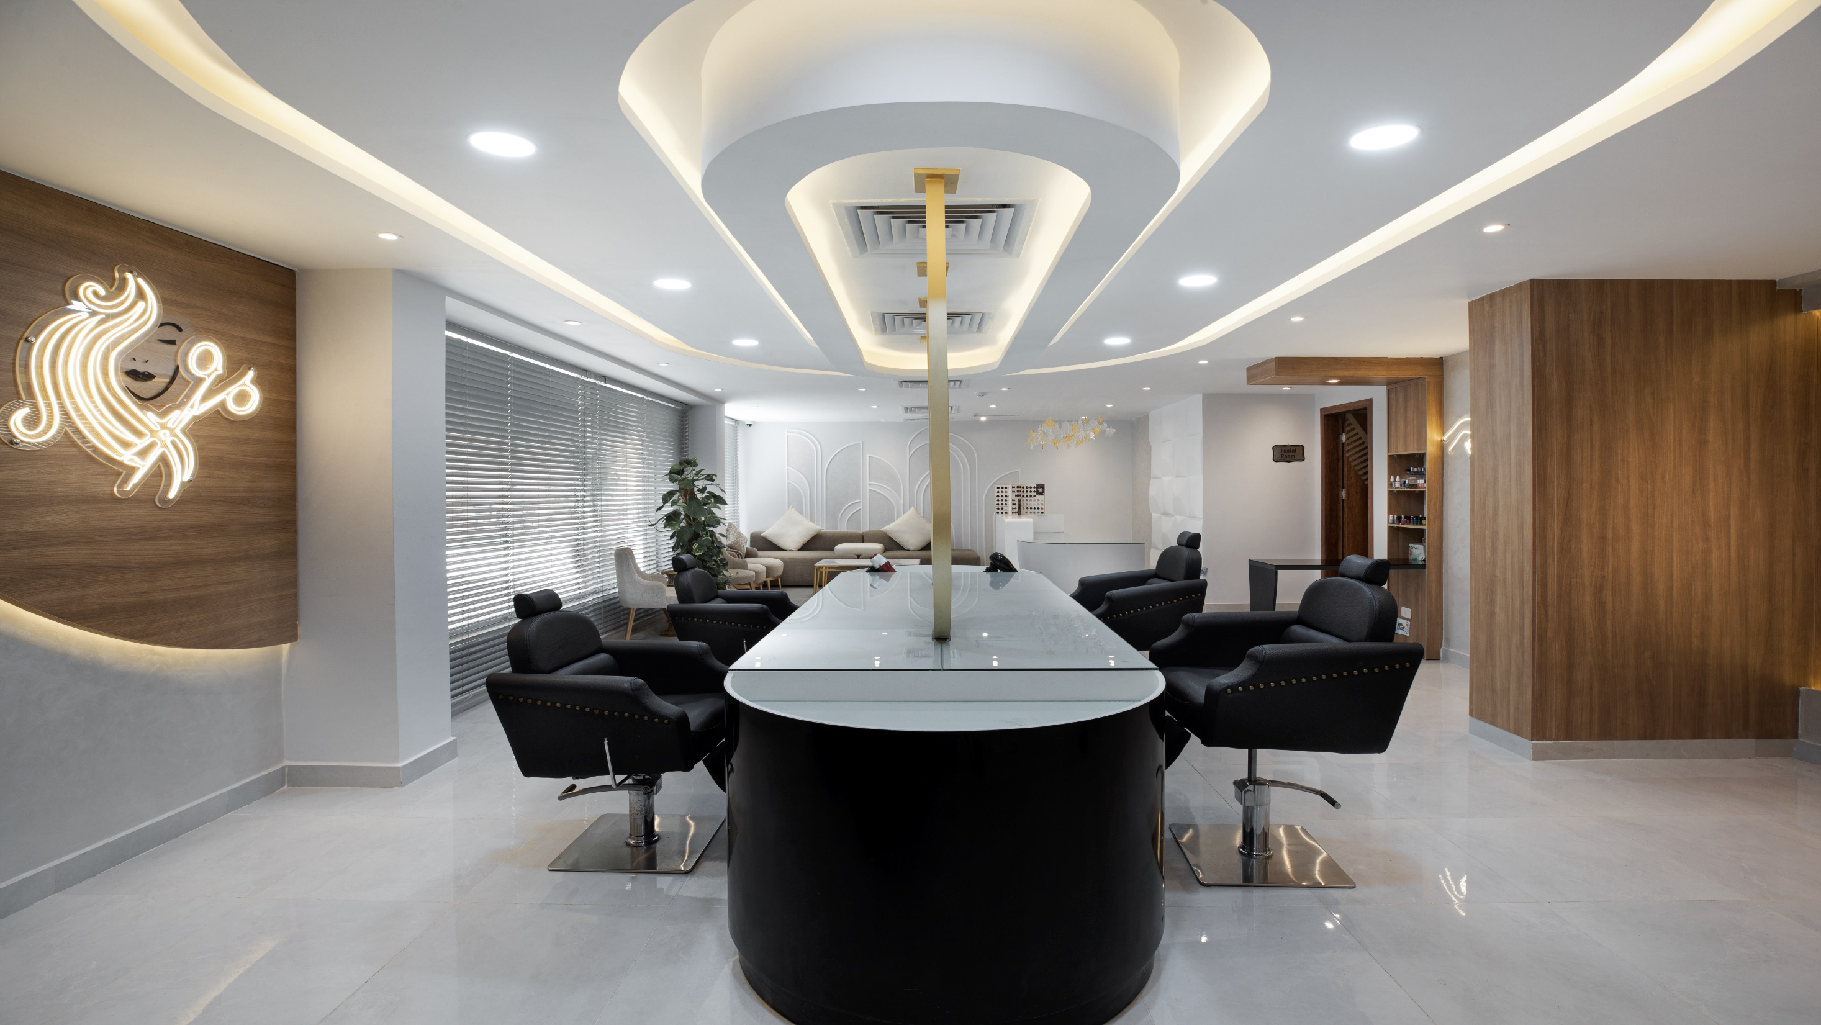

Slide 50
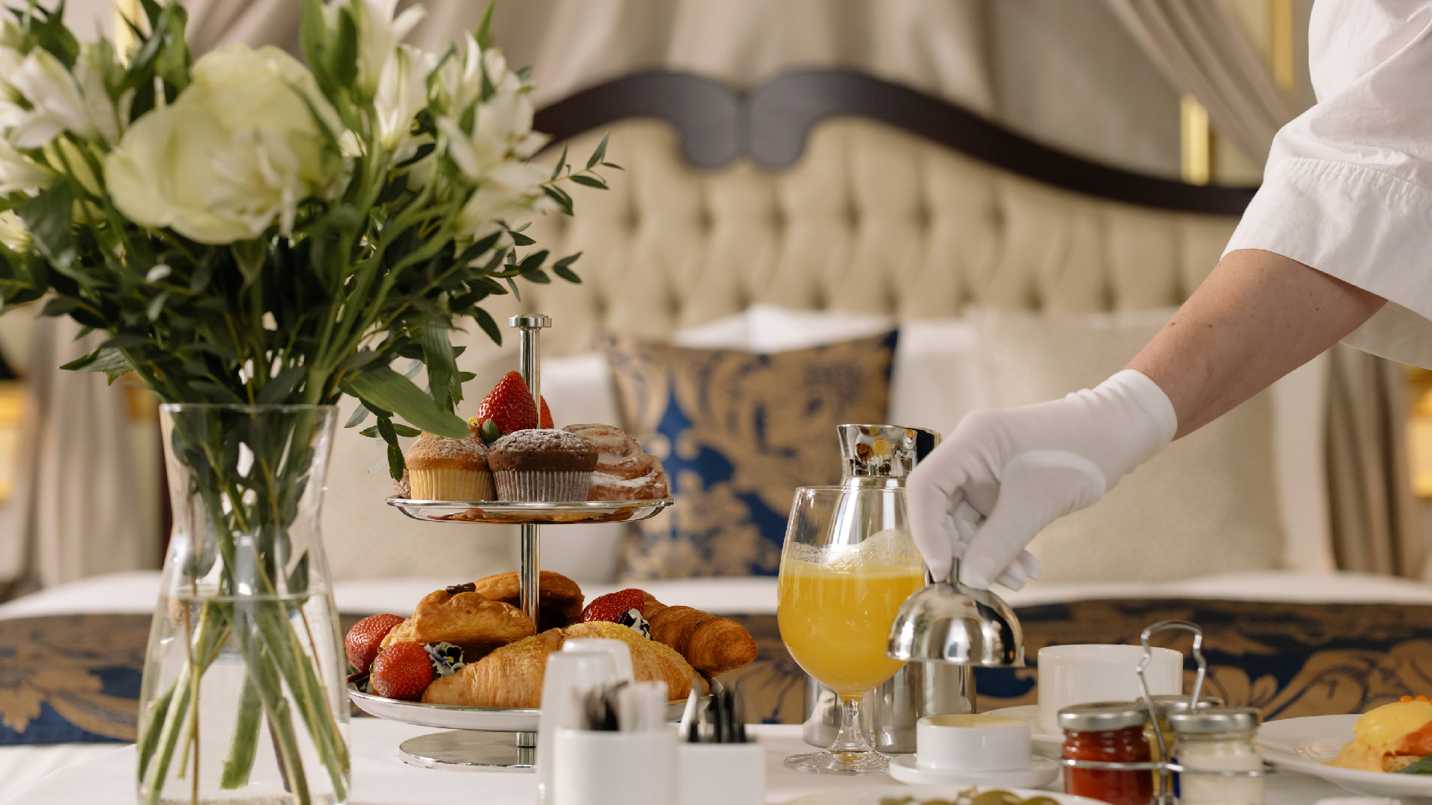
Services provided within the premium all inclusive concept

Slide 51
Other Services
Guest prearrival courtesy call to accommodate any special requirements, to ensure guest satisfaction at The V. this service arranged by The V Butler Team
Room massage is available by request
Laundry (free three pieces laundry cleaning and ironing, dry cleaning is
not included)
Dry cleaning is available upon request
Room service as well in room chef dinning service is available upon request
Chef service is available everywhere upon request with the arrangement of
butler team.
Luggage service available one day prior departure

Slide 52
Cleaning will be between 09:00 – 17:00. Guest can also call Guest Relation team for a preferred different time .
Rooms turn down service will be between 19:00 till 21:00
Mini bar service includes daily refiling of mineral water and the coffee tray
(tea and coffee).
Mini bar replenishment twice per week (6 cans soft drinks, 4 juices,
packets of Potato Chips and 2 bars of chocolate)
Free baby seating service is available from 08:00 till midnight in Kids Club
All rooms have a free safe box to store valuables
Hight speed wireless internet in rooms and public areas
SPA center, GYM and beauty salon
Limousine service is available upon request
Valet service is available

Slide 53
Entertainment

Slide 54
Entertainment
Main pool
Heated pool
Pool cabanas with jacuzzi
Aqua park pool with 2 slides
Children aqua park
Sandy beach – the longest sandy beach in Sahl Hasheesh with total length of 900 m.
Daily kids activity
Kids club providing a safe and cheerful time for children at daytime between 10:00-12:30 and
14:30 -17:00. We also organize evening events for between 20:00 – 20:30
Live music and soft entertainment
Running and cycling track
Beach and pool activities and sports
Aqua center and diving center (against charge)

Slide 55
Meeting Rooms

Slide 56
Meeting Rooms
Convention Centre & Banquets Hall
Pyramisa Sahl Hasheesh Convention Center is the biggest conference facility in the entire Red Sea area and is a top choice for any kind of meetings, conferences, seminars & weddings.
Having 7 spacious conference rooms that can accommodate up to 1000 persons.
All meeting rooms are fully equipped with the latest meeting
equipment’s.

Slide 57
Meeting Rooms
Name | Size (sq.) | Length | Width | Theater | Classroom | Banquet | “U” Shape | Reception
Grand Hall | 834 | 34.75 | 24 | 600 | 400 | 500 | 200 | 1000
Topaz | 144.90 | 15.75 | 9.2 | 140 | 80 | 110 | 40 | 80
Coral | 43.88 | 6.75 | 6.5 | 60 | 20 | 40 | 15 | 40
Emerald | 43.88 | 6.75 | 6.5 | 60 | 20 | 40 | 15 | 40
Pearl | 43.88 | 6.75 | 6.5 | 60 | 20 | 40 | 15 | 40
Turquoise | 43.88 | 6.75 | 6.5 | 60 | 20 | 40 | 15 | 40
Diamond | 106.31 | 15.75 | 6.75 | 120 | 40 | 90 | 50 | 60

Slide 58
THANK YOU

